Slide 1
THG Simulations
Project update
Week 5
18/08/2023
David Amorim

Slide 2
Simulations
An extensive round of parameter scans was carried out, involving over 5000 simulation runs
considered Ar, Ne, Kr, Xe, He, N2, and N2O
beam powers: 75mW, 150mW, 200mW, 300mW, and 400mW
pressures: 0.1bar to 5.1bar in 0.1bar increments
density profiles: gradient and COMSOL
The scan outputs consisted of:
total UV energy & efficiency
UV pulse duration
UV output spectrum
Position in the cell of the UV energy peak
Caveats: the simulations used the ADK ionisation model instead of PPT; at the time of writing, the simulations have not yet finished!

Slide 3
Overview
Compare the two density models
Compare the profiles themselves
Show general results of pressure scan comparisons
In-depth case study
Compare different gases
Identify “conditions of interest” (combinations of pressure, beam power, and gas that result in >100nJ sub-2fs UV pulses)

Slide 4
I. COMSOL V. GRADIENT

Slide 5
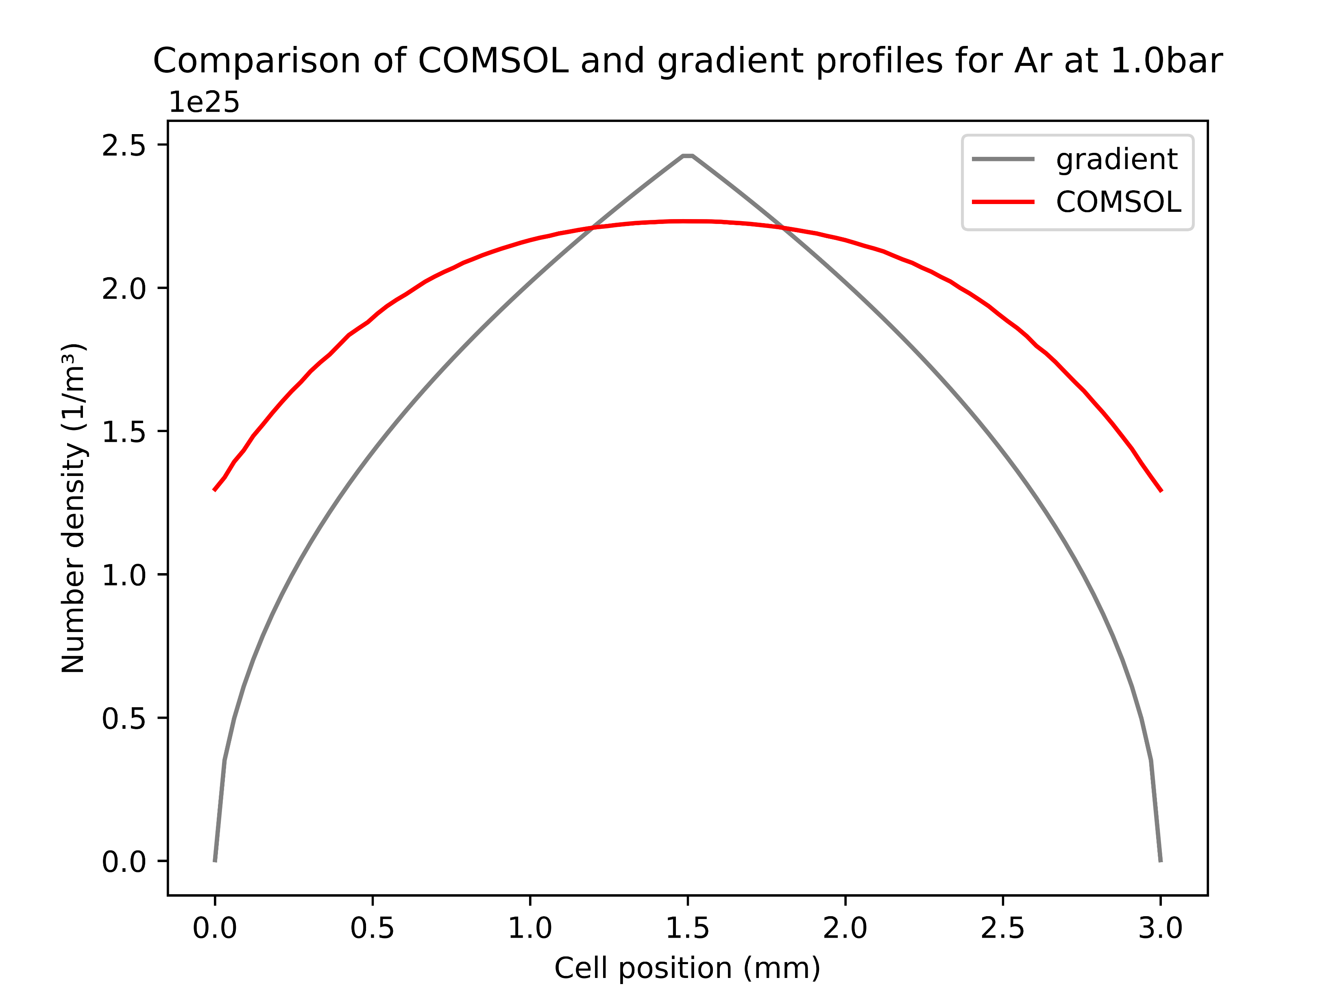
The density profiles
Gradient profile has a higher peak and steeper drop-off than COMSOL
This difference is (qualitatively) unchanged when varying the pressure
Most importantly but not shown here: COMSOL also includes the region outside the cell (3.5cm on either side)
Overall, fairly good agreement of the two models within the cell

Slide 6
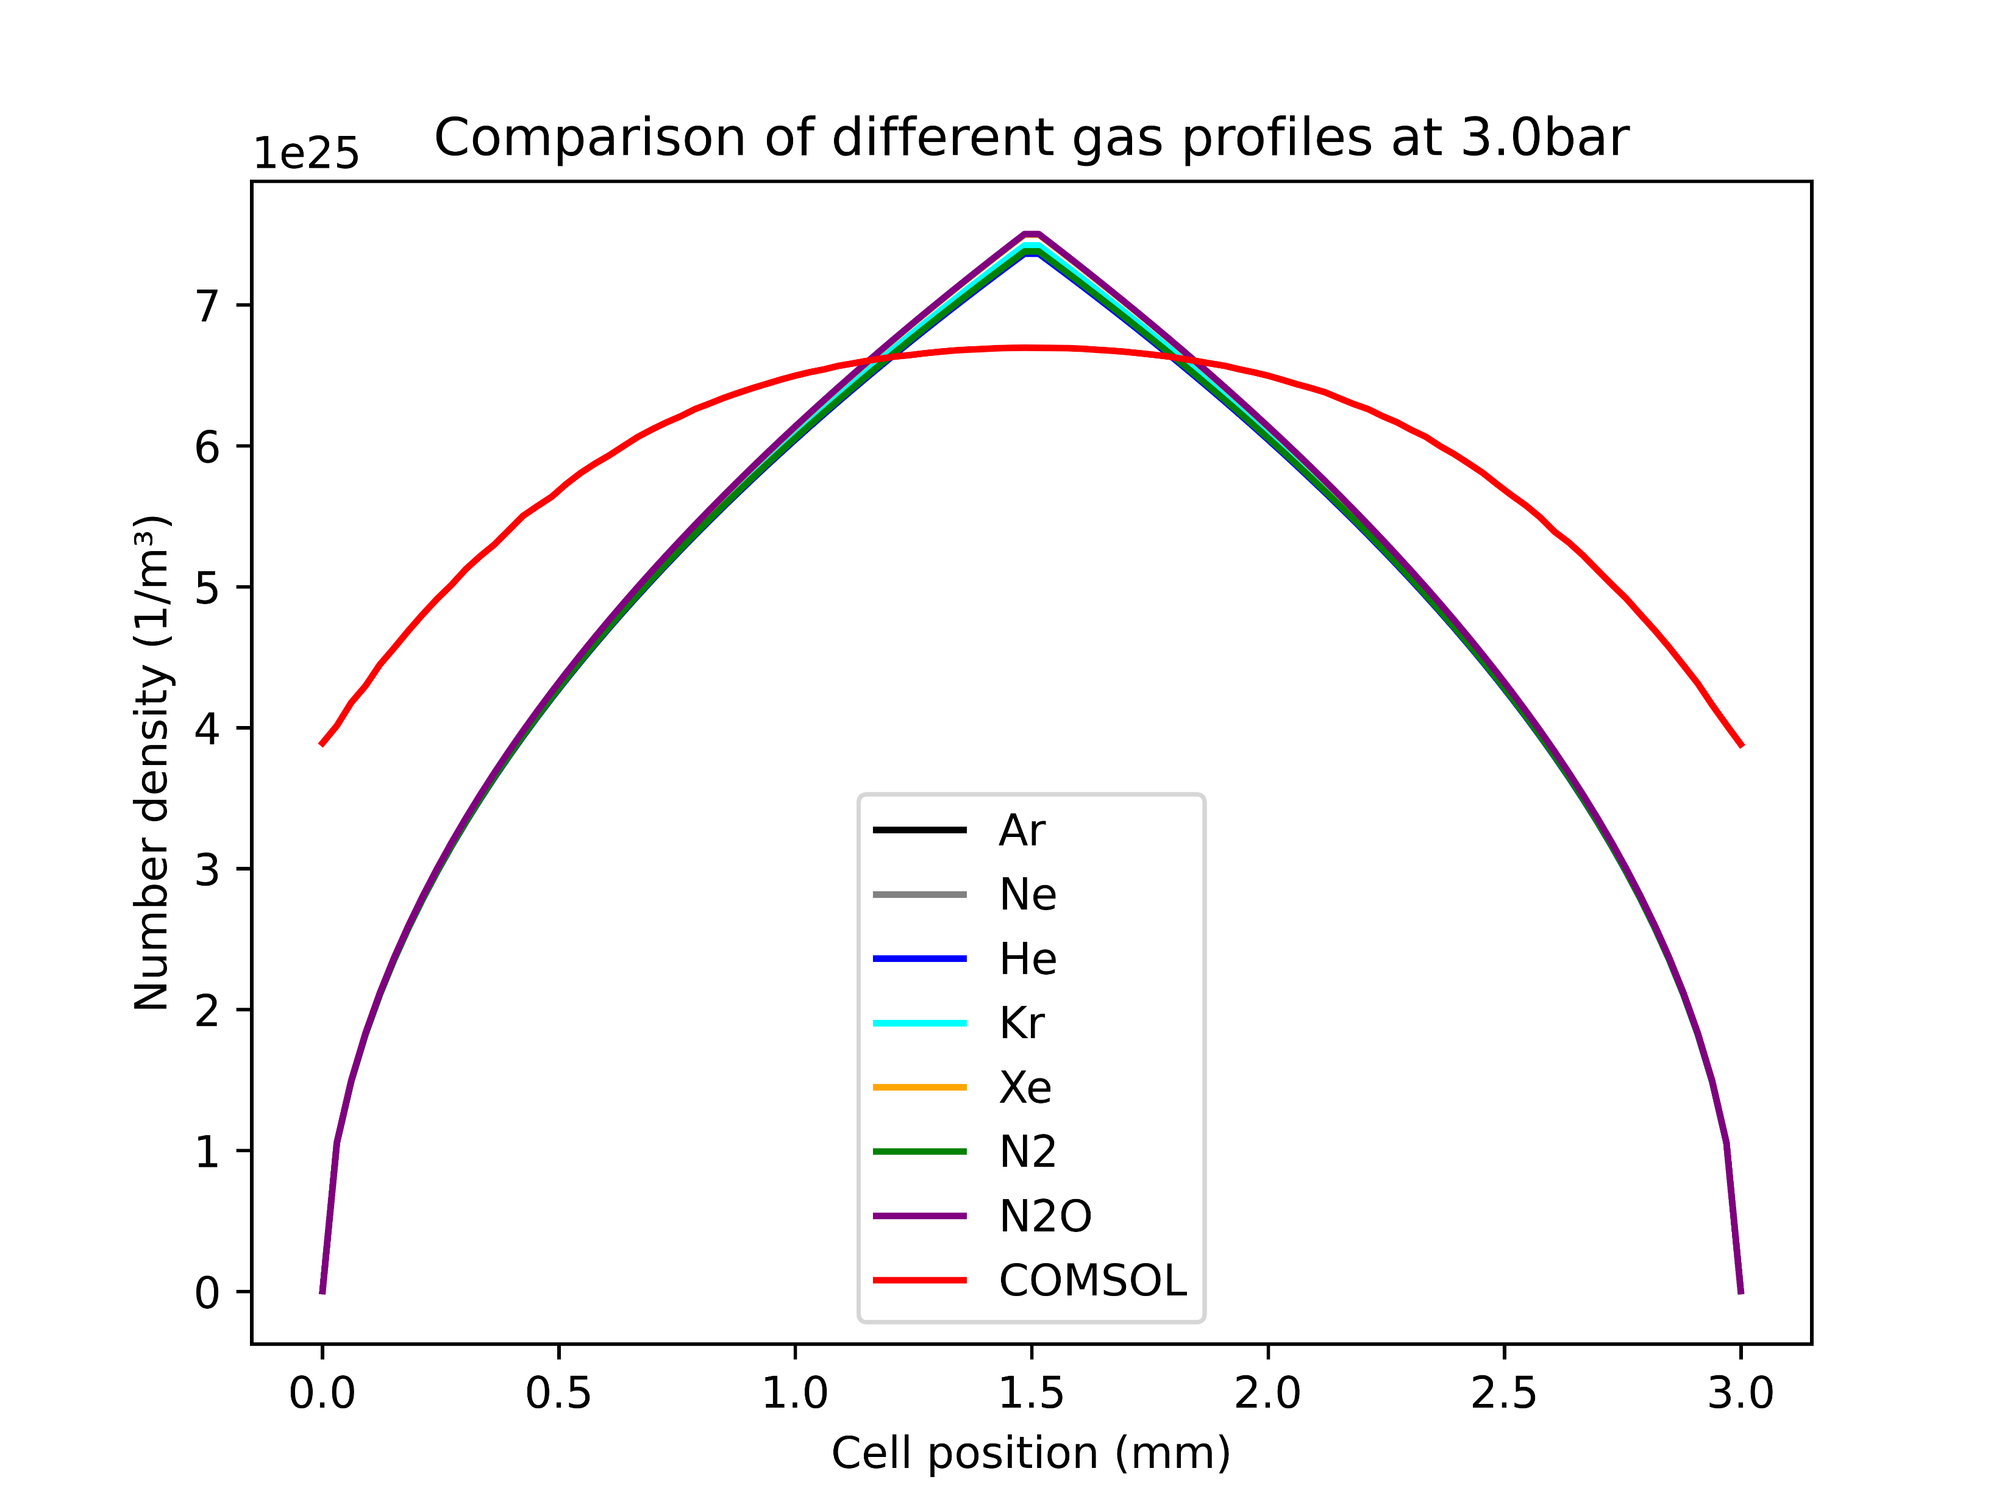
The density profiles
The COMSOL simulations are only based on Argon
However, at the given pressures there is barely any difference in the density profiles of various gases
Thus, the COMSOL model was also used for the other gases in the parameter scans
Note: the COMSOL data used here was not generated with the improved high-Mach model!

Slide 7
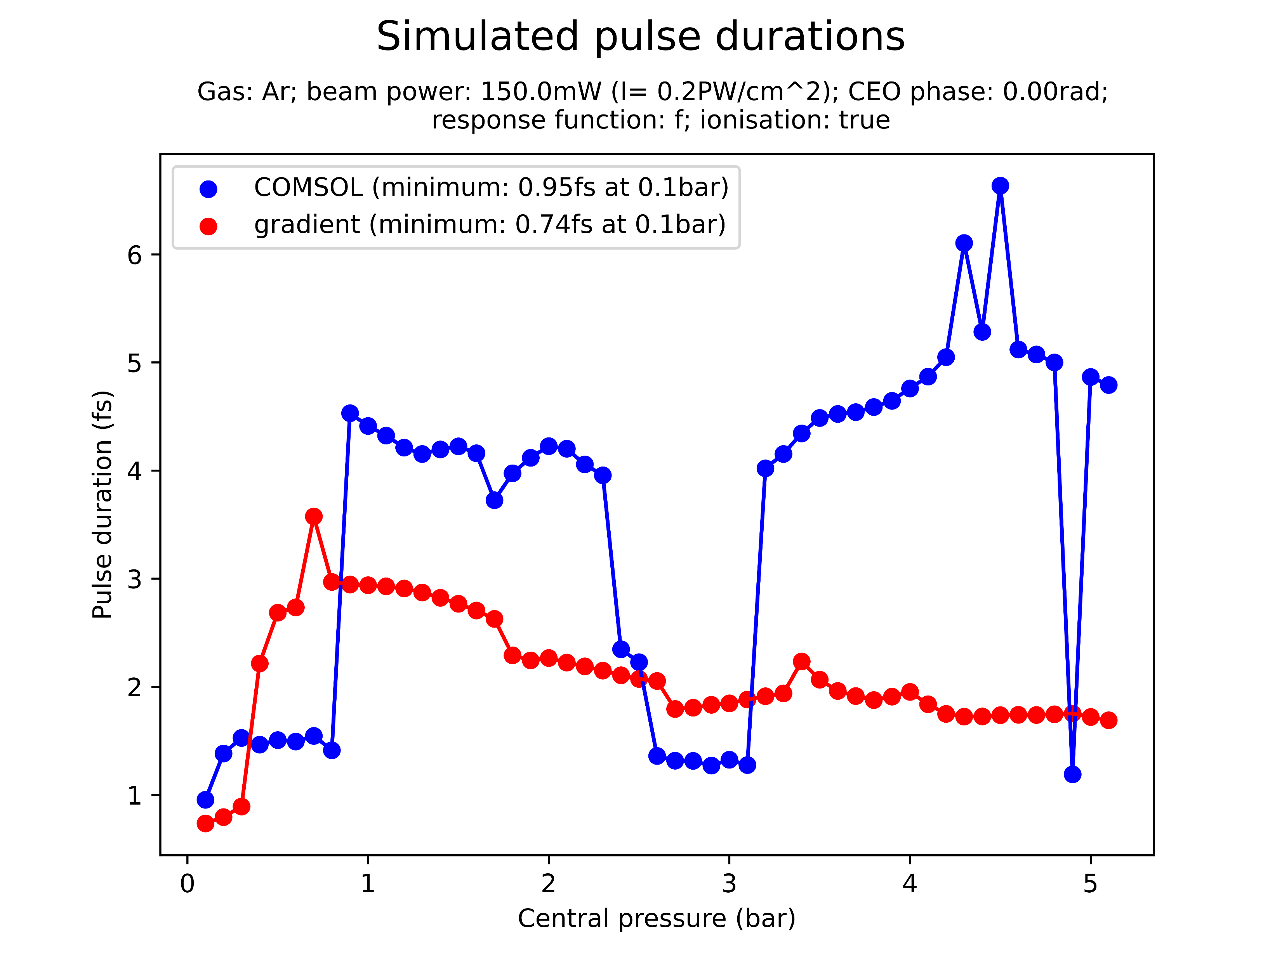
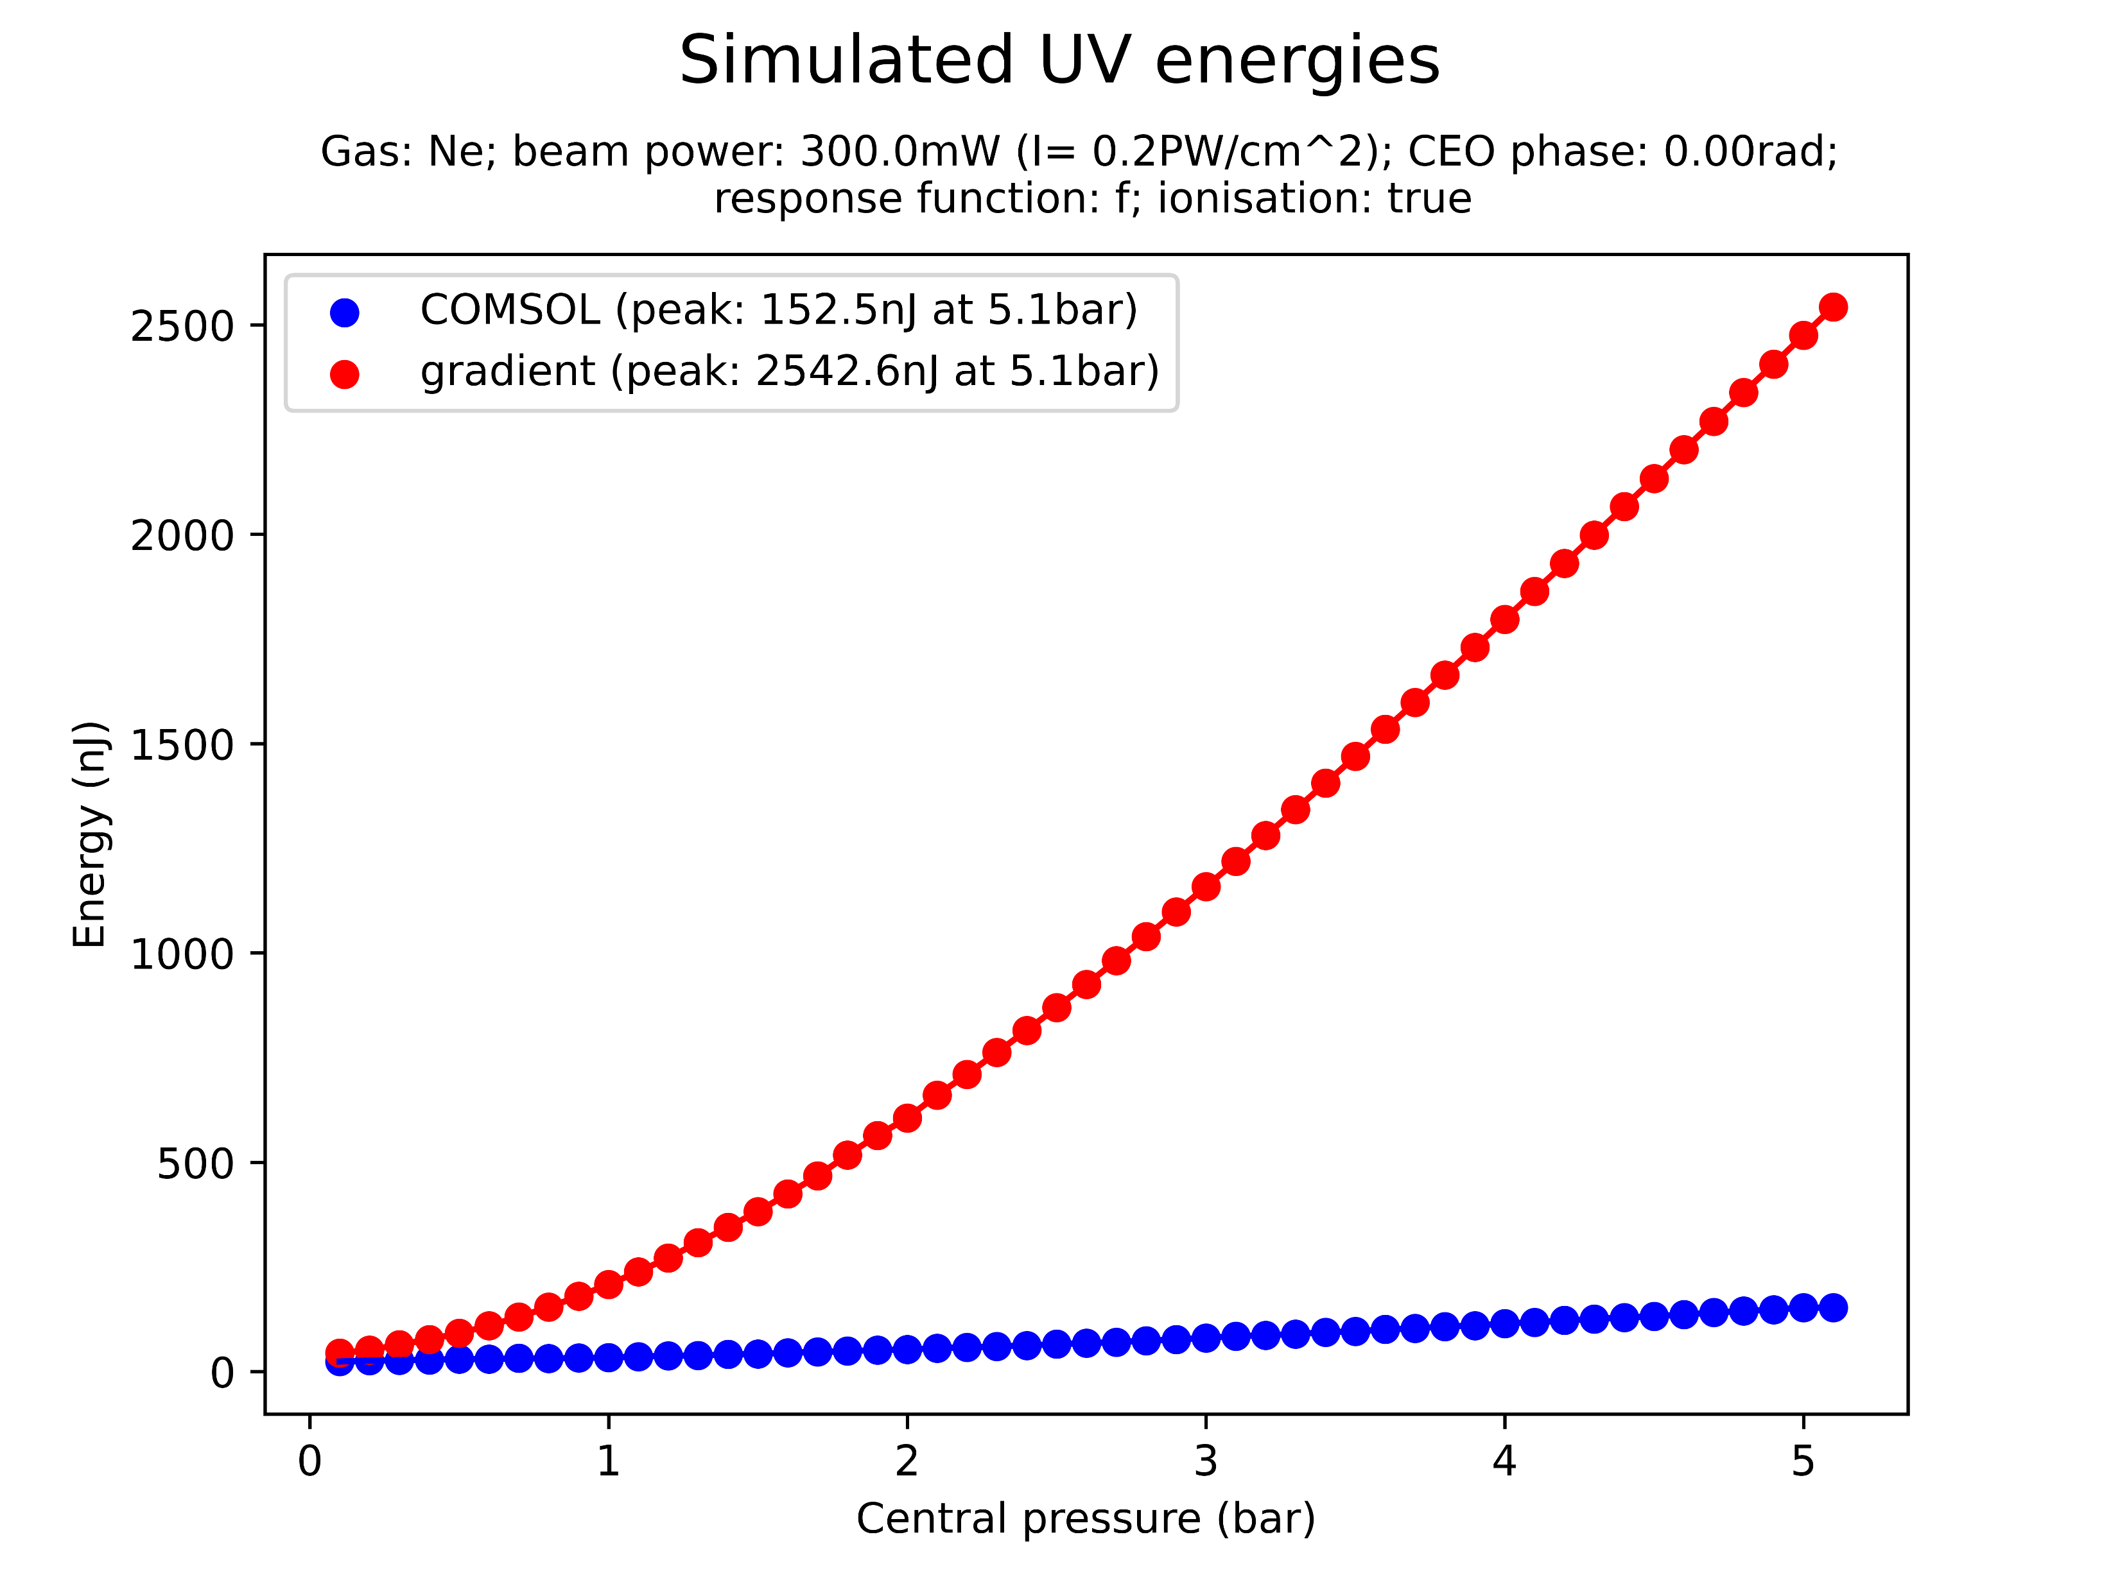
Pressure scan comparisons
The COMSOL and gradient models were compared in a variety of pressure scans
Across all beam powers and pressures, COMSOL predicts a significantly lower UV energy output
Exception: 300mW N2O!
There is also generally disagreement between the simulated pulse duration, although without a clear pattern
Note: FWHM pulse durations are used, which are sensitive to pulse shape and can hence be misleading!
Note: the plots above are random examples and not related

Slide 8
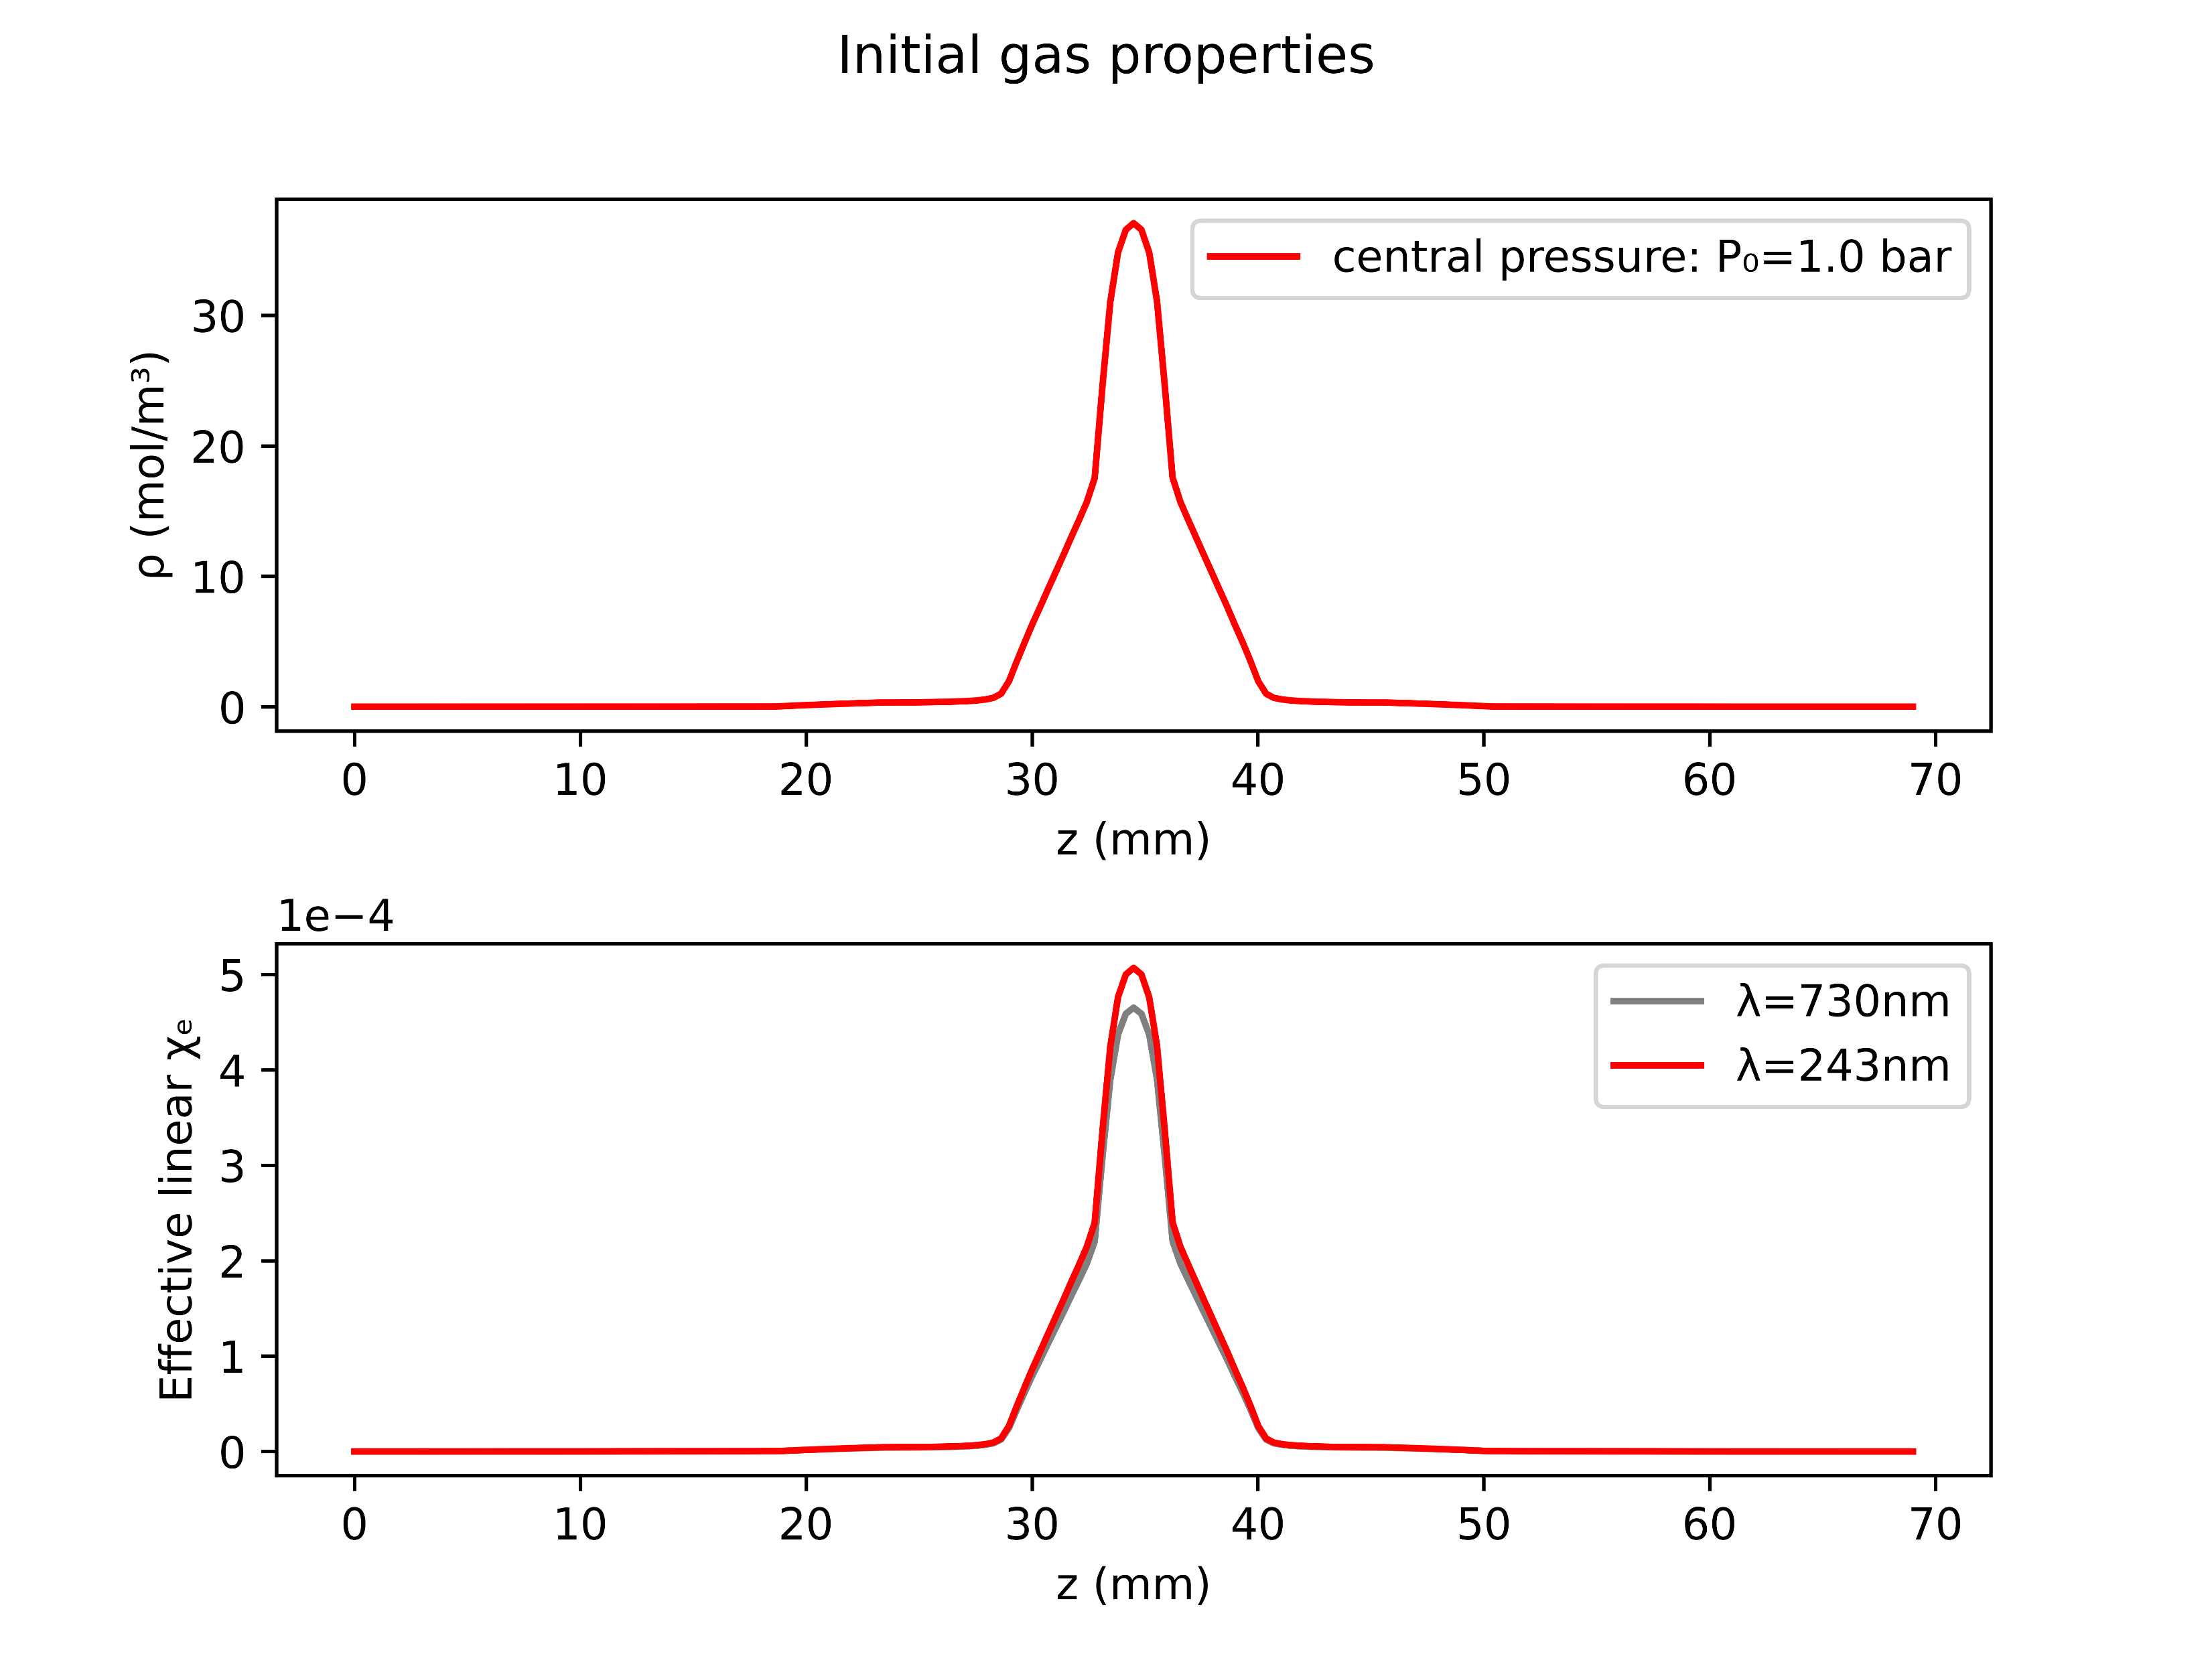
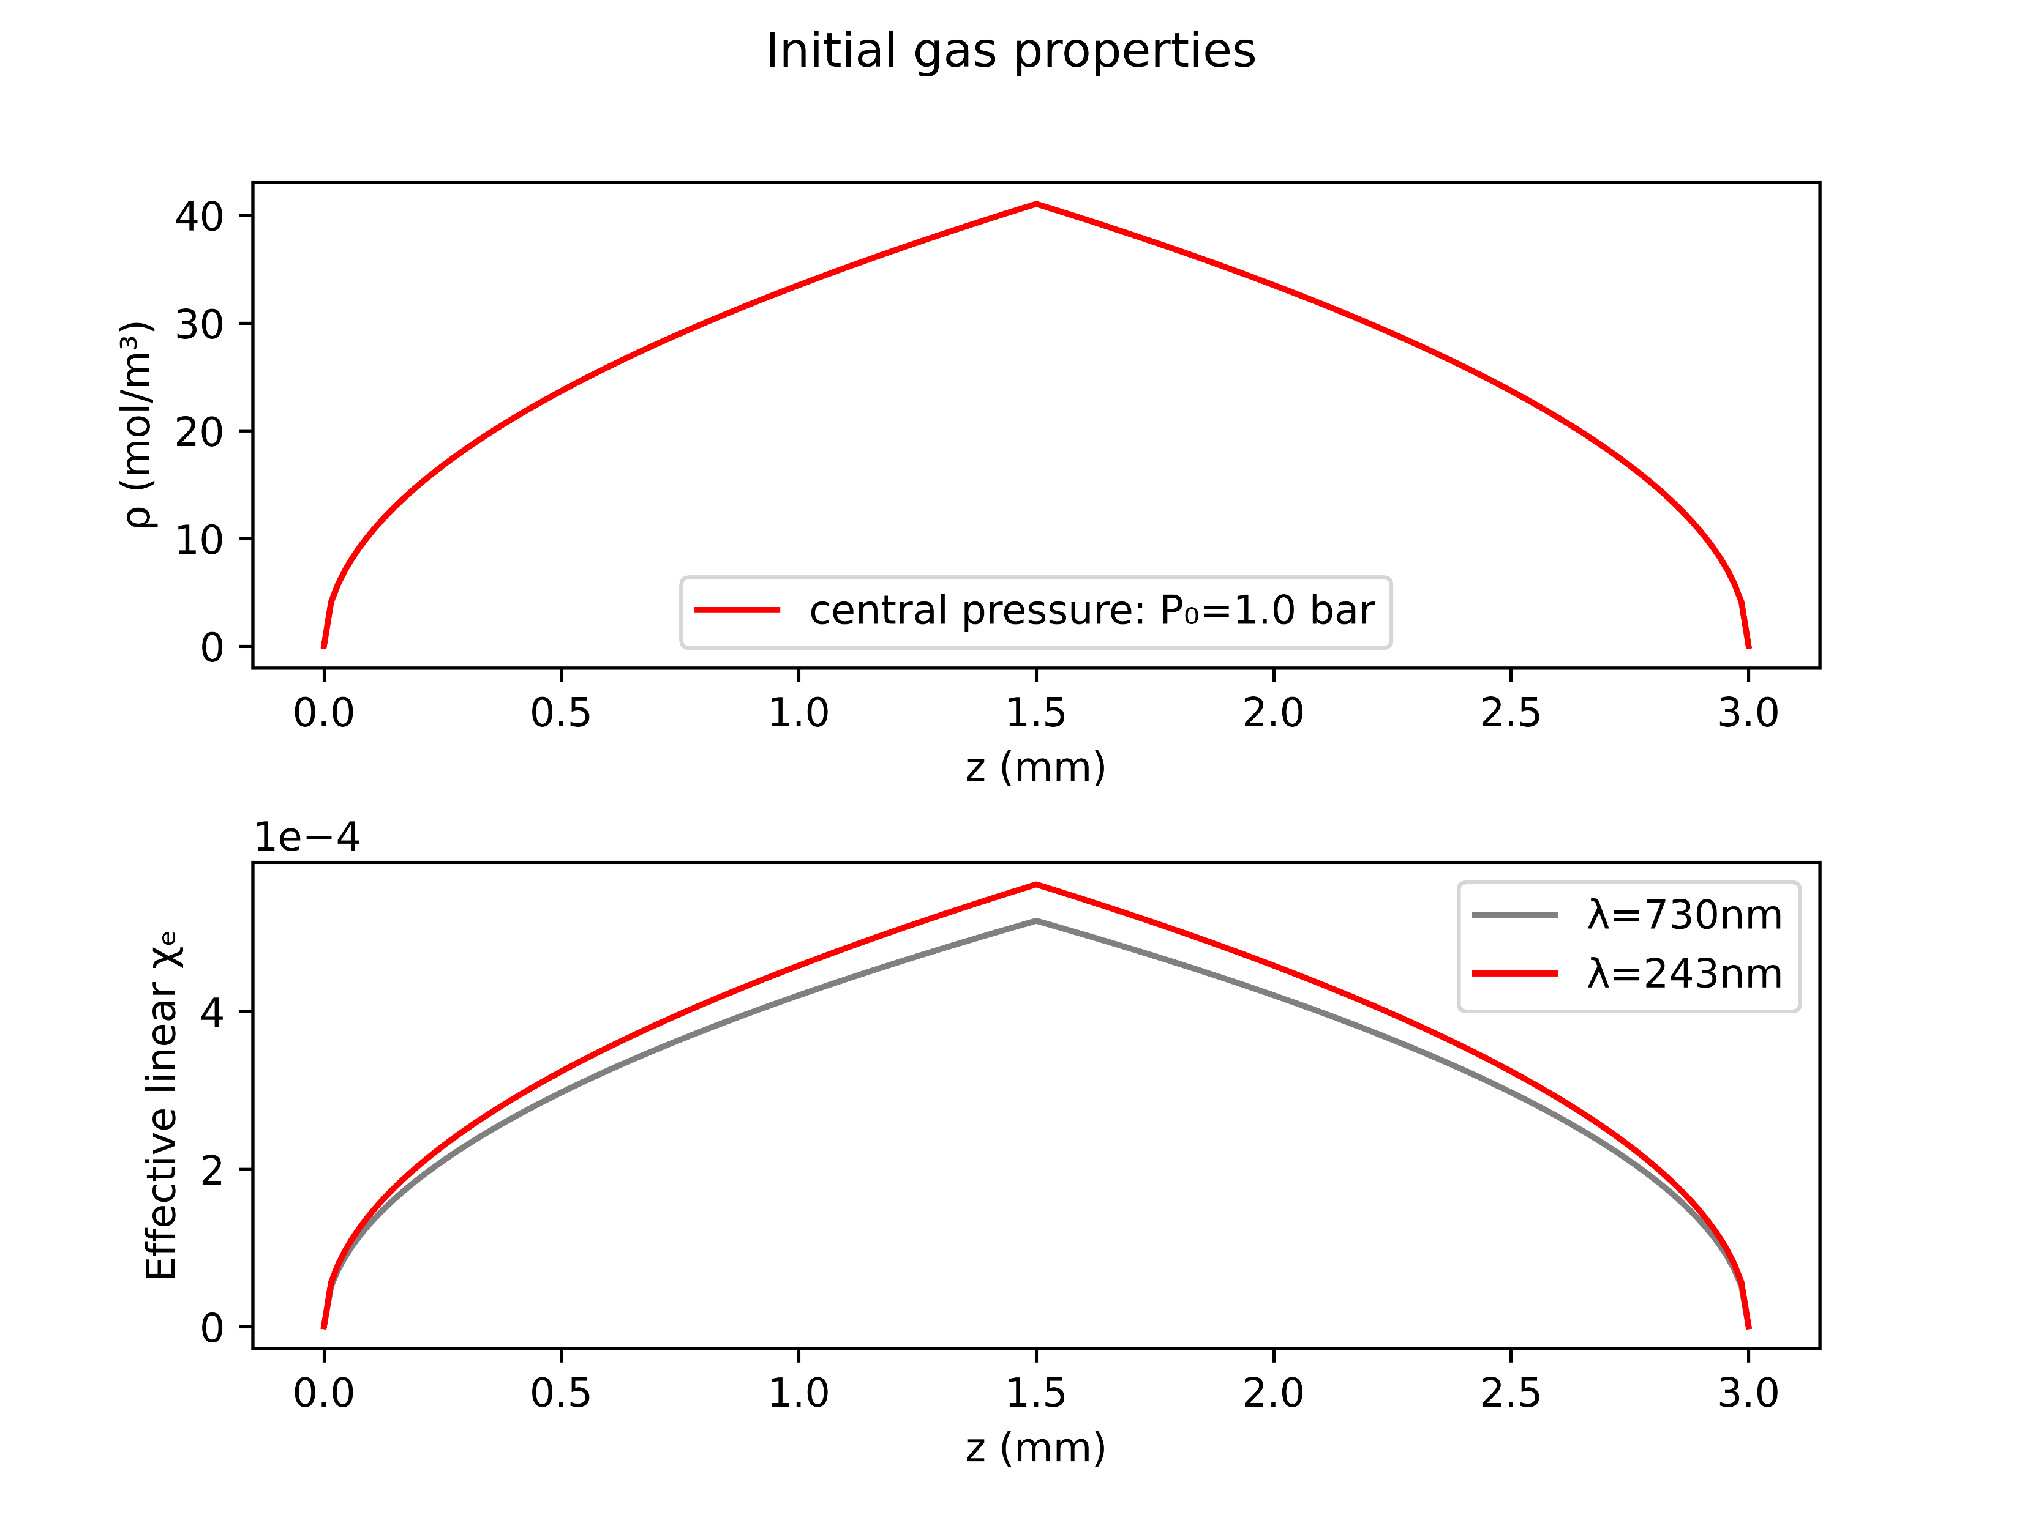
Case study: Argon at 1.0bar with 150mW
COMSOL
gradient

Slide 9
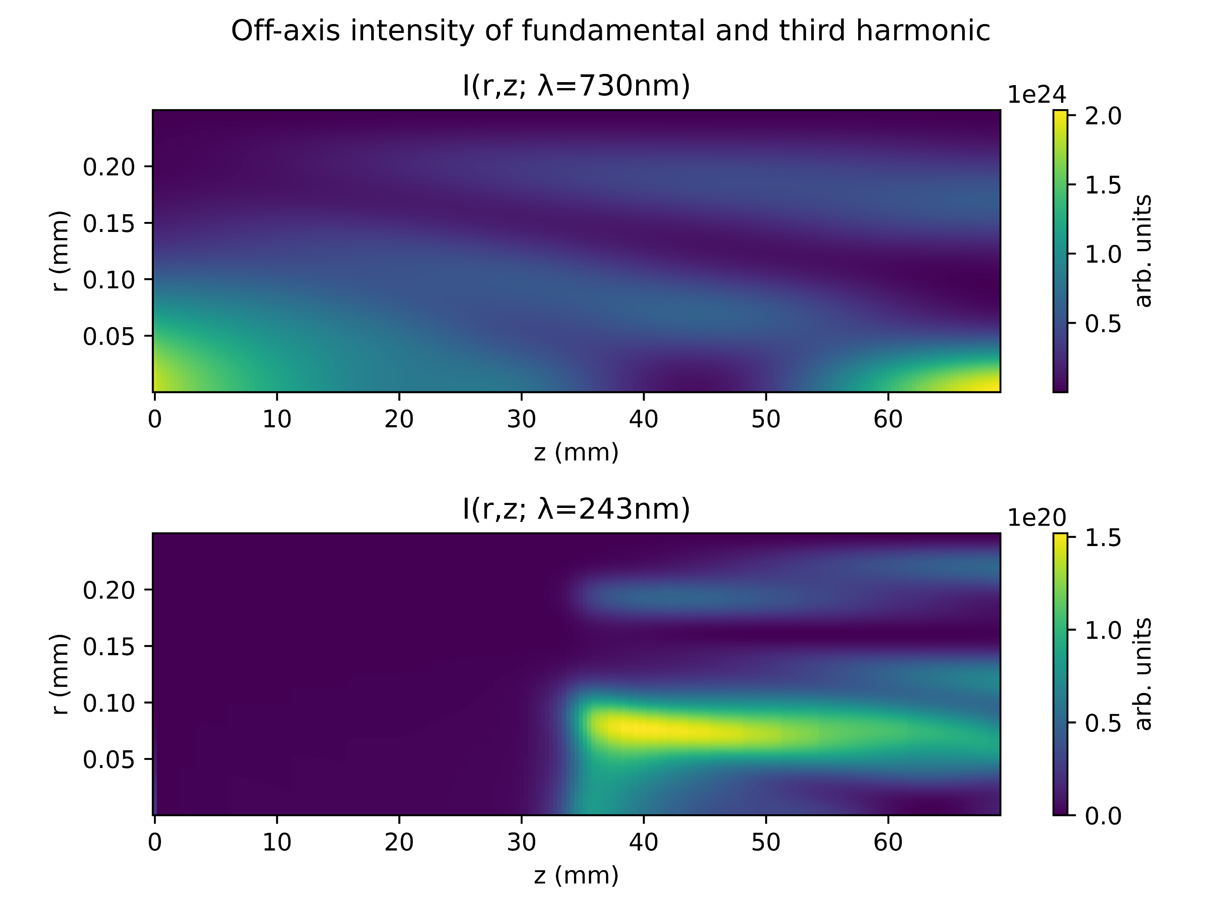
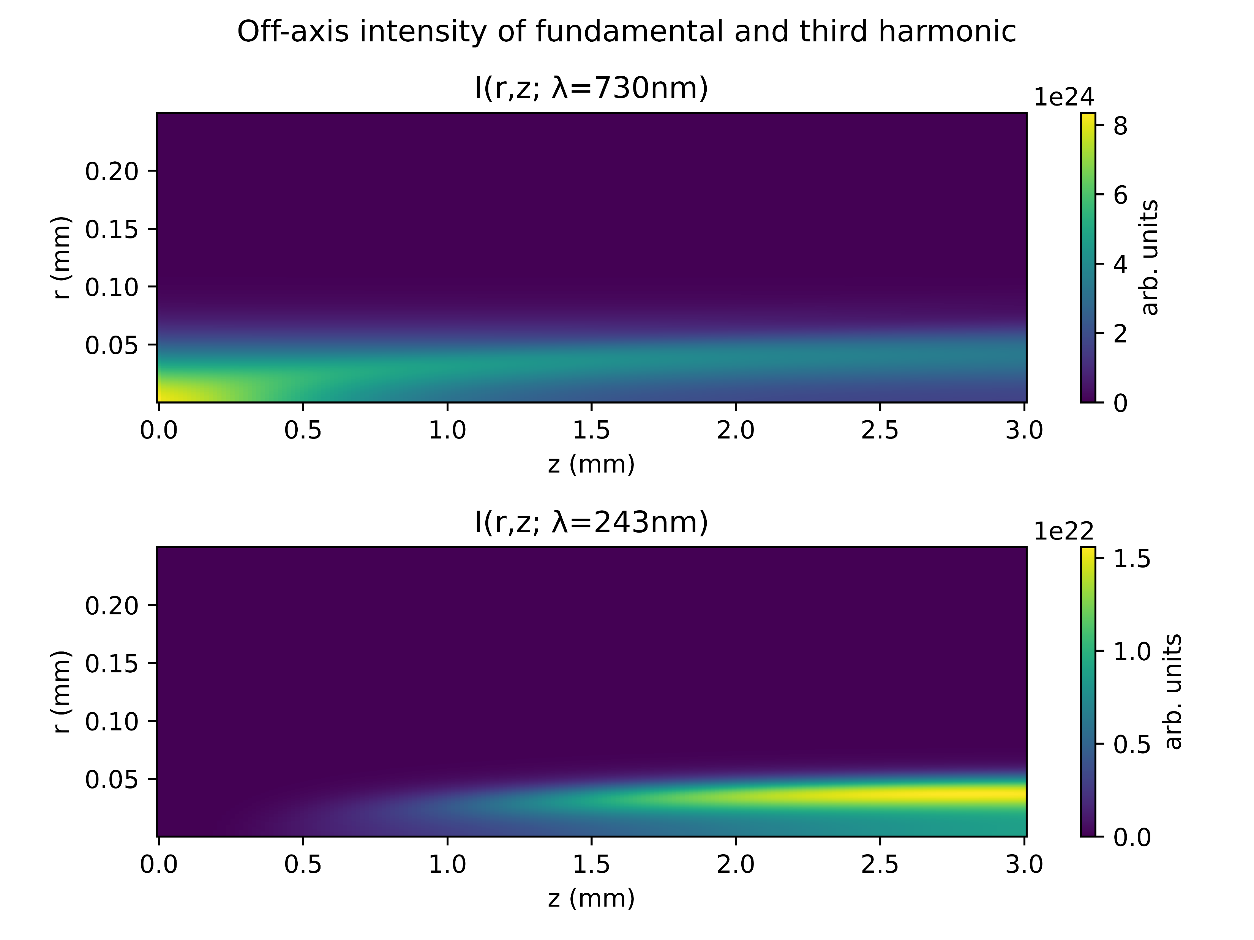
Case study: Argon at 1.0bar with 150mW
COMSOL
gradient

Slide 10
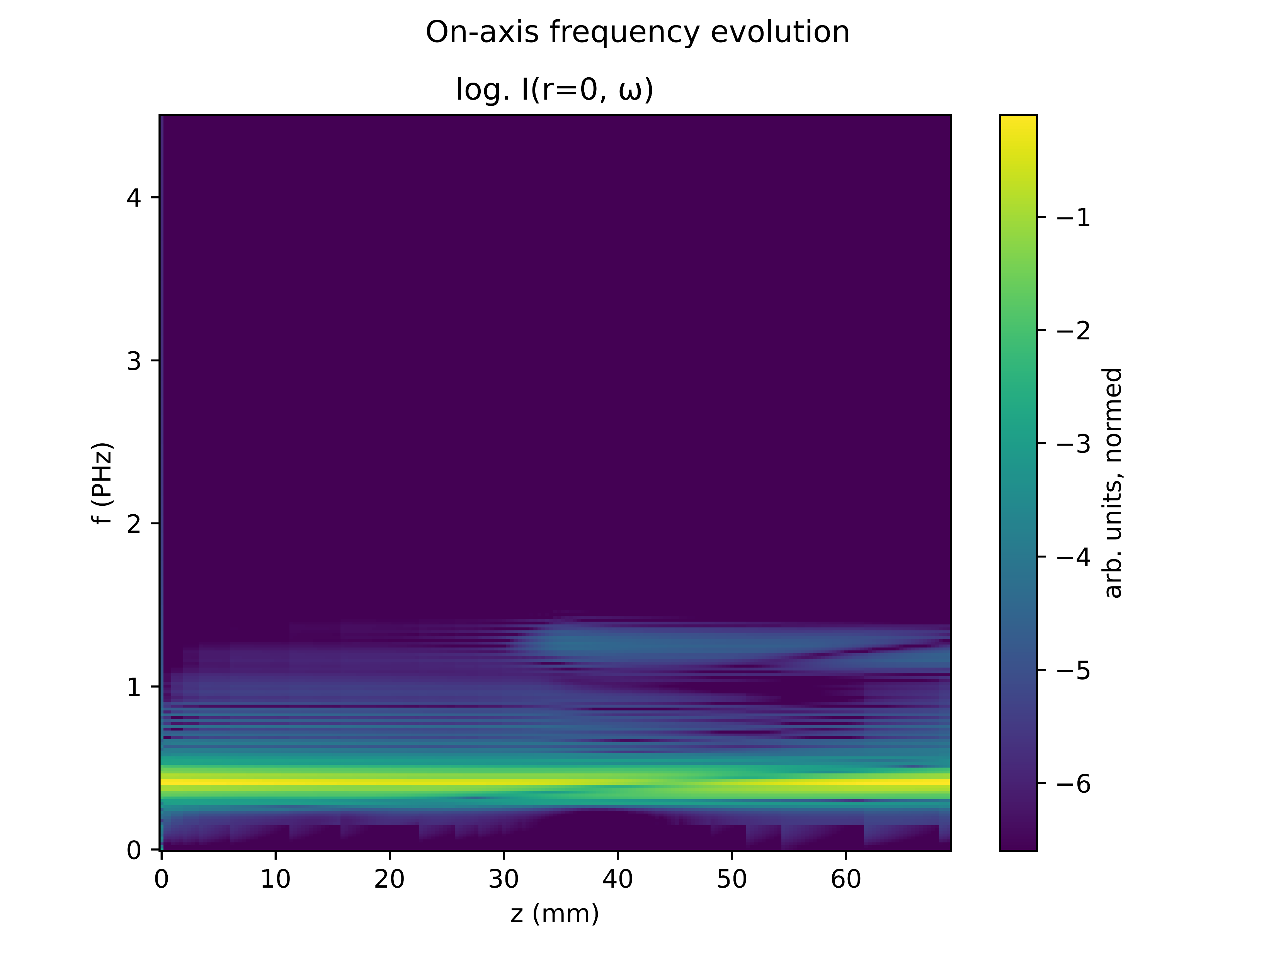
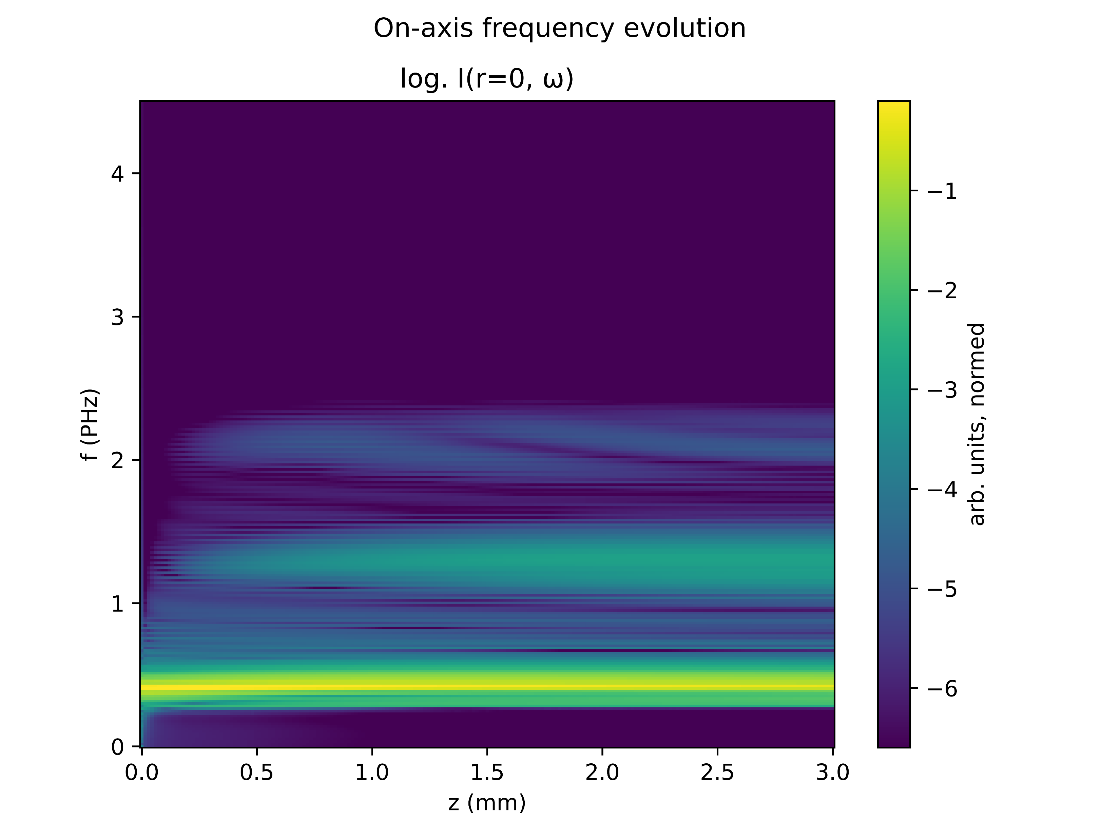
Case study : Argon at 1.0bar with 150mW
COMSOL
gradient

Slide 11
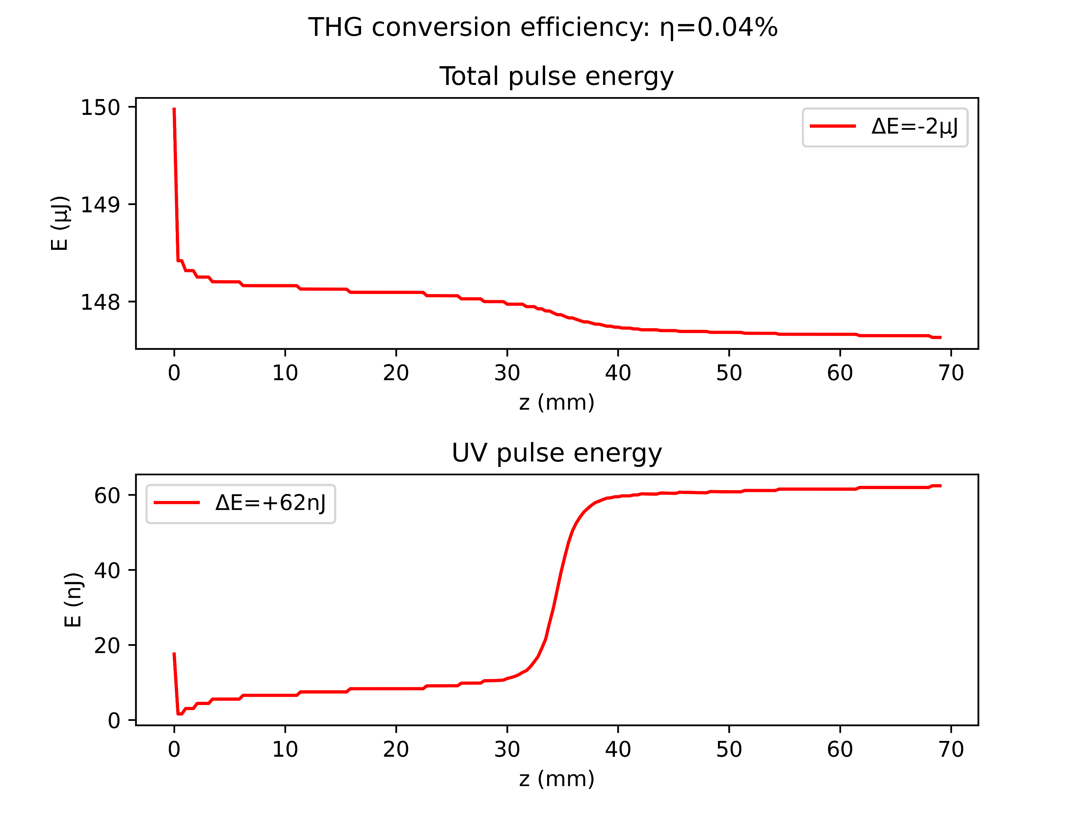
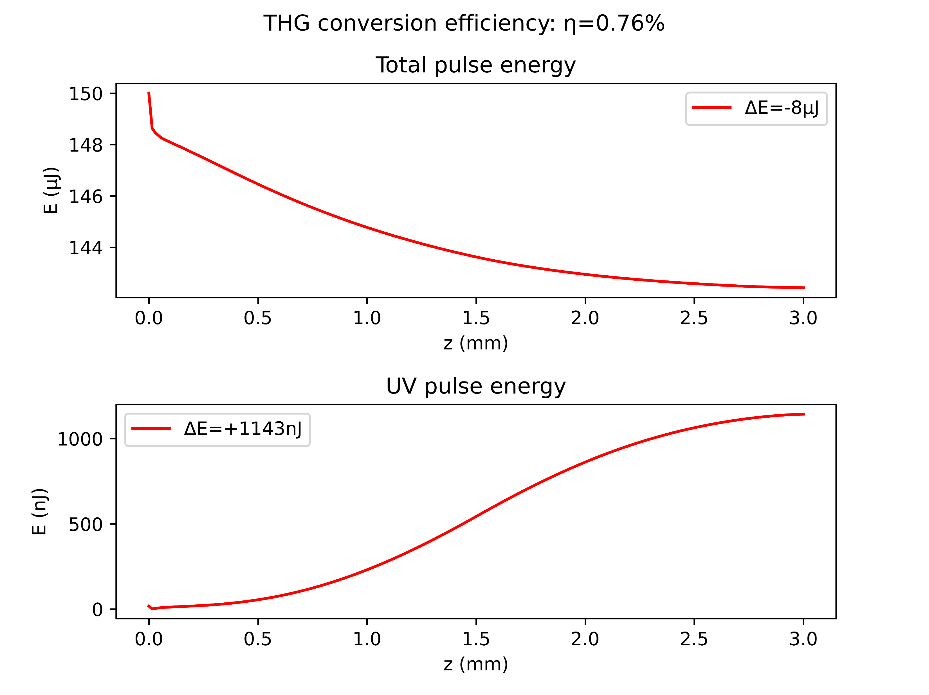
Case study: Argon at 1.0bar with 150mW
COMSOL
gradient

Slide 12
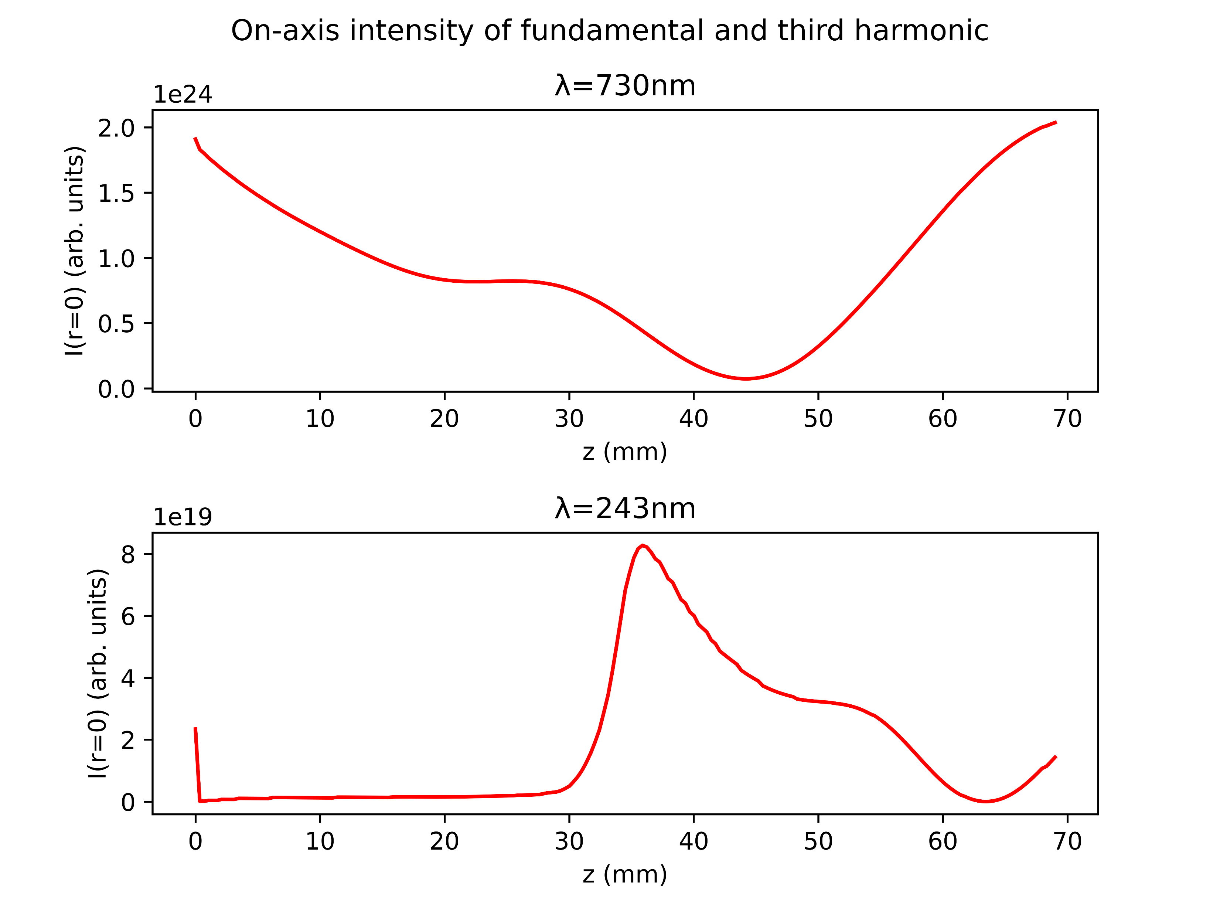
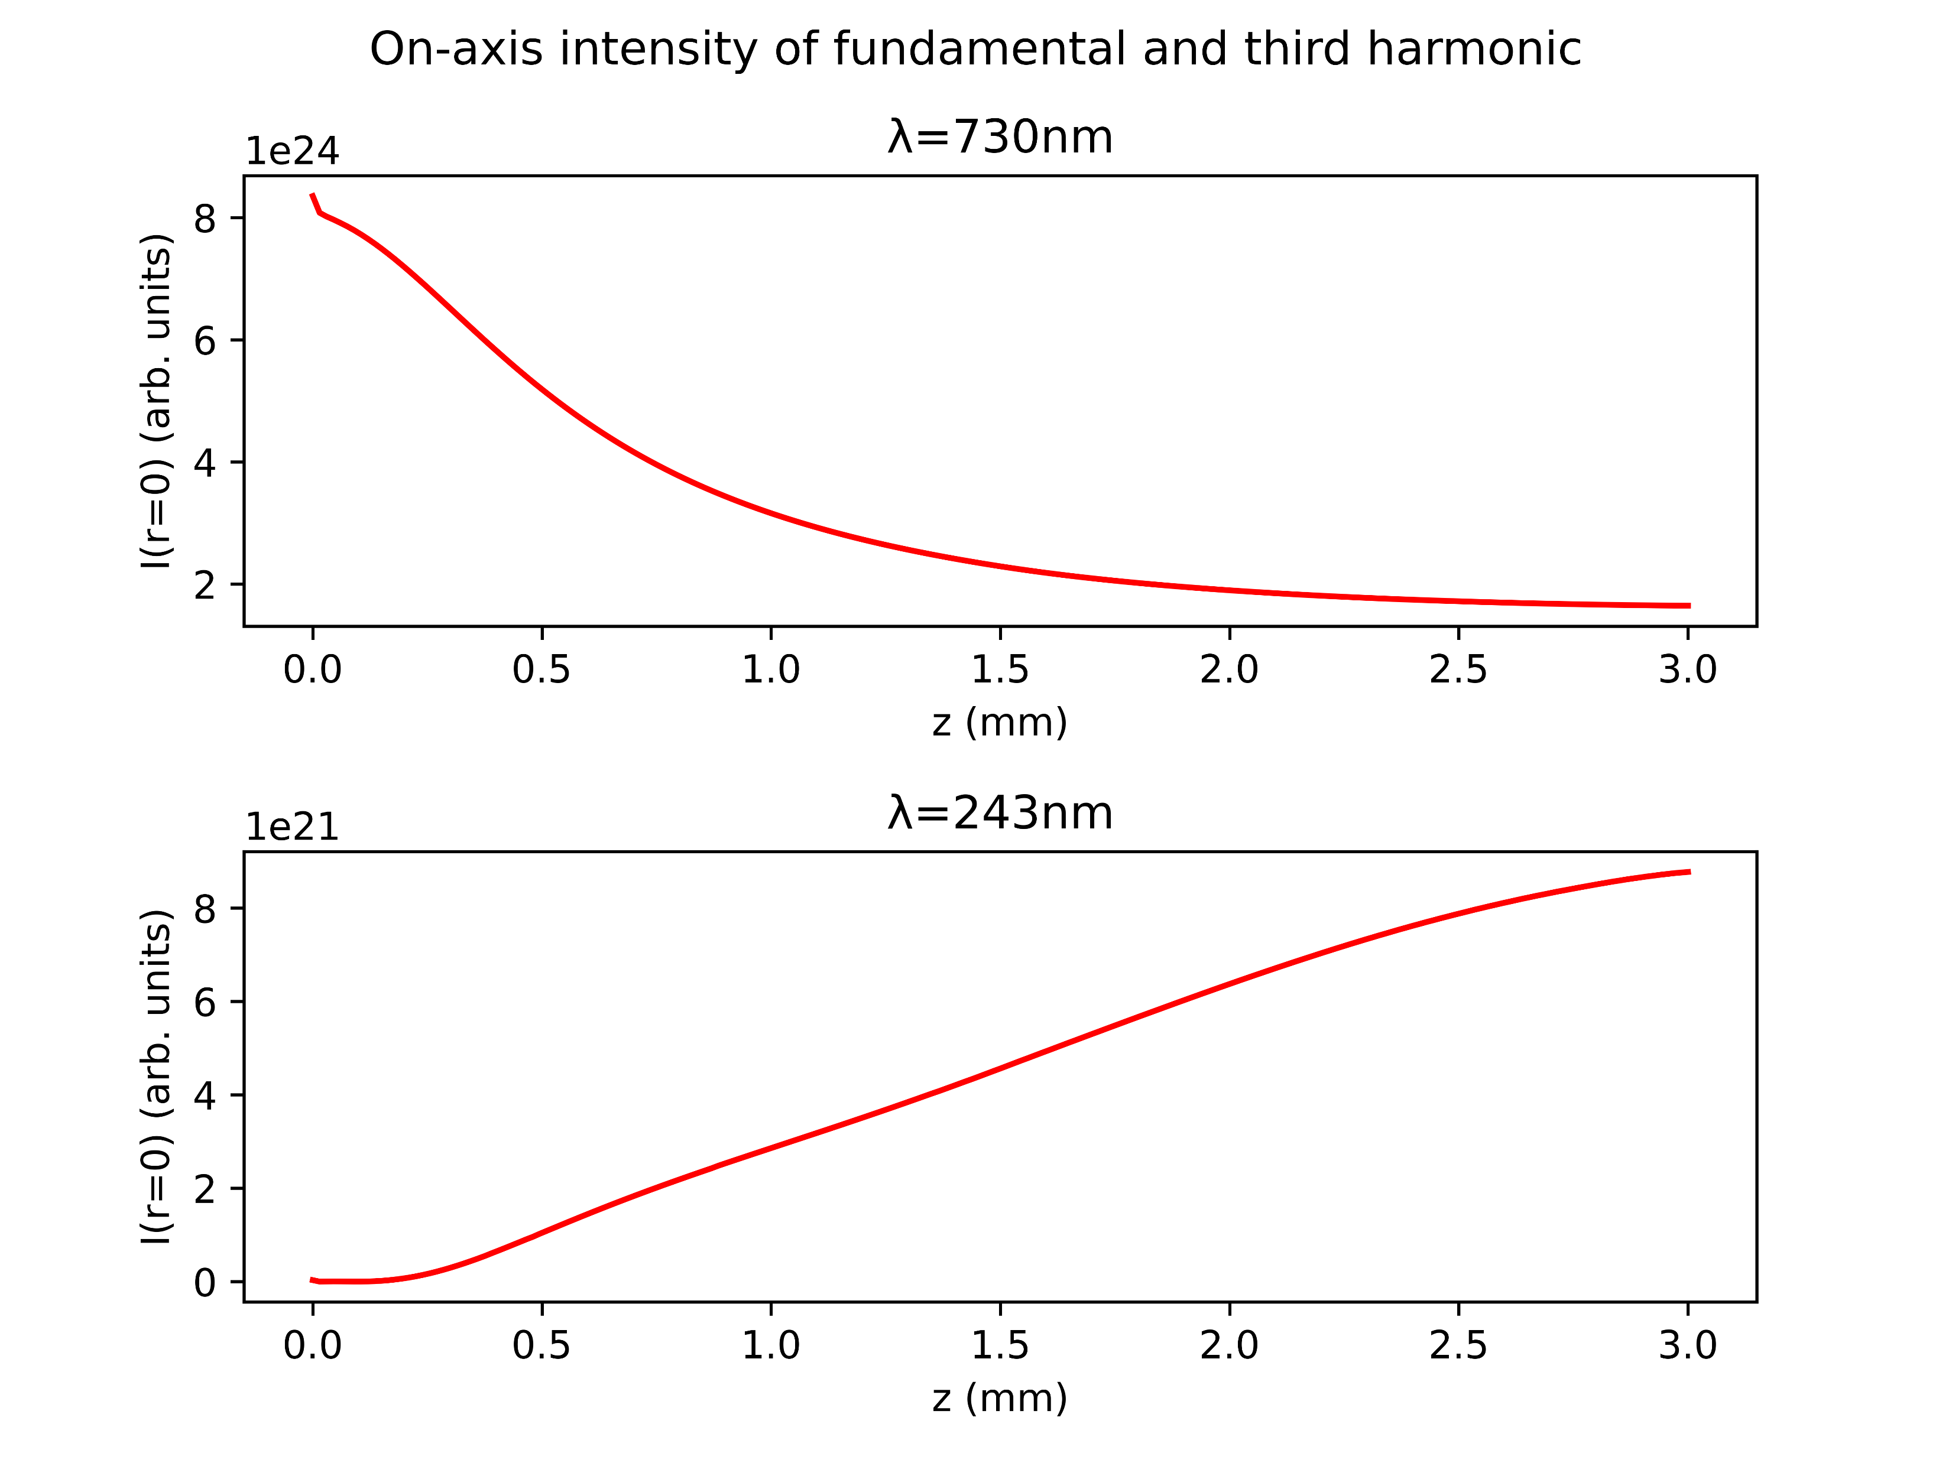
Case study: Argon at 1.0bar with 150mW
COMSOL
gradient

Slide 13
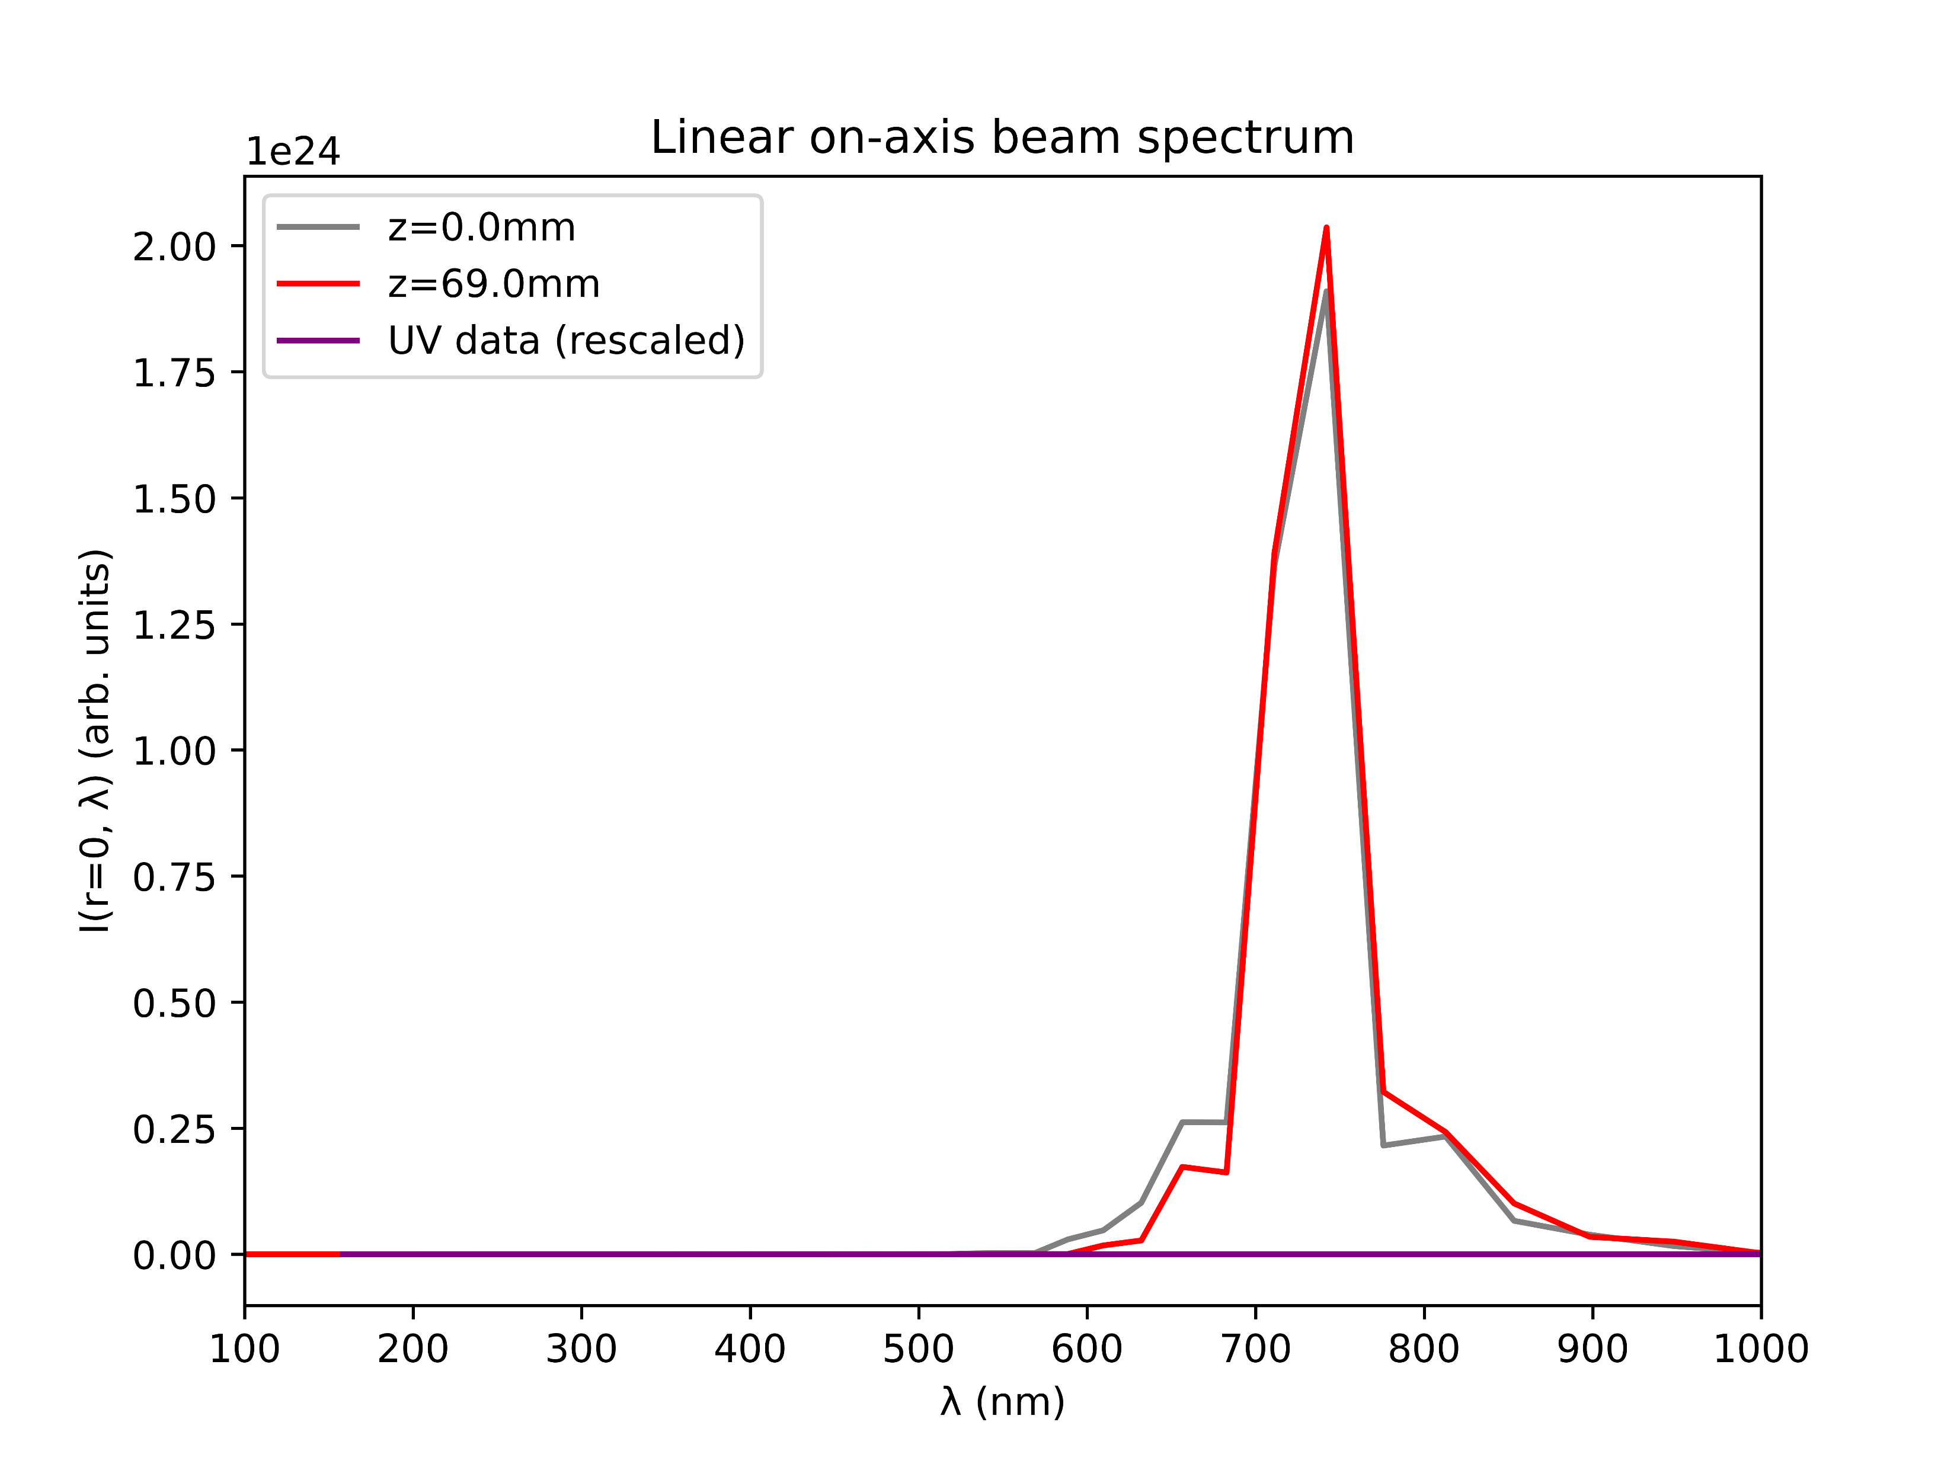
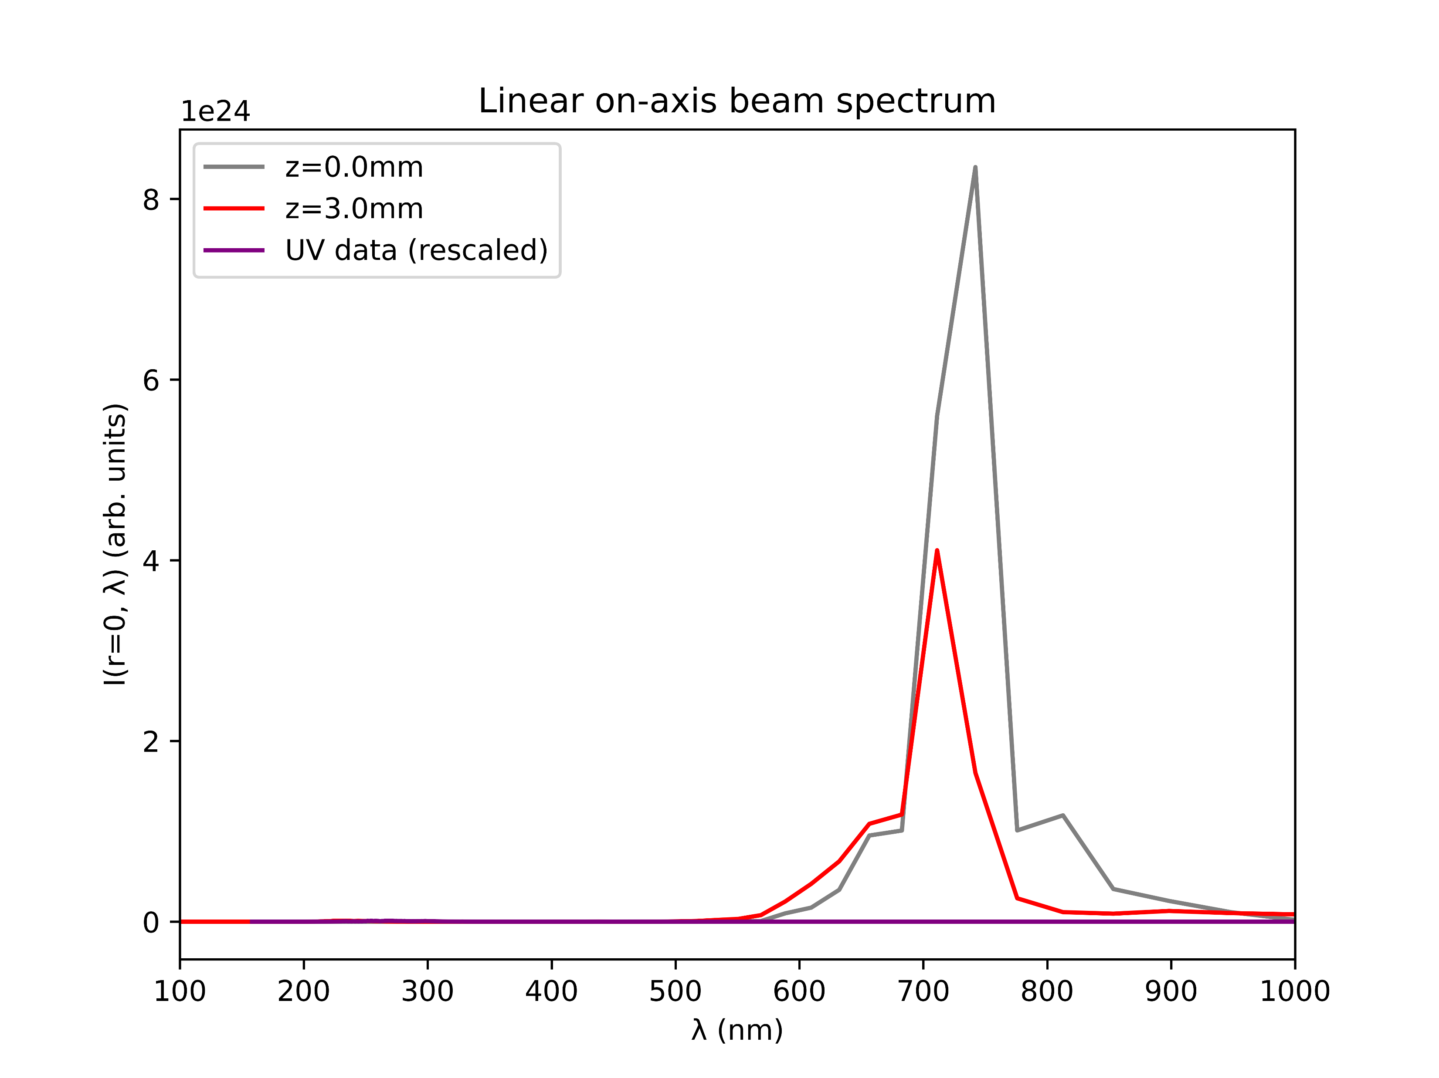
Case study: Argon at 1.0bar with 150mW
COMSOL
gradient

Slide 14
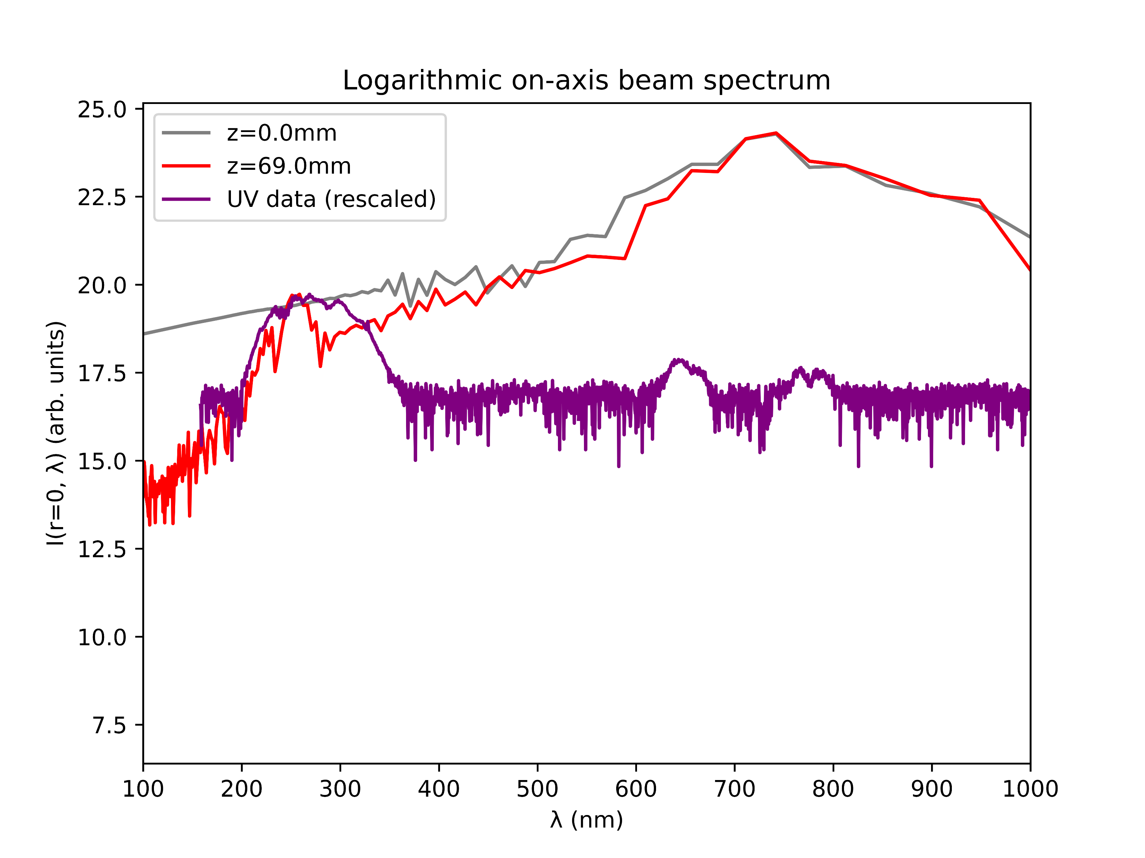
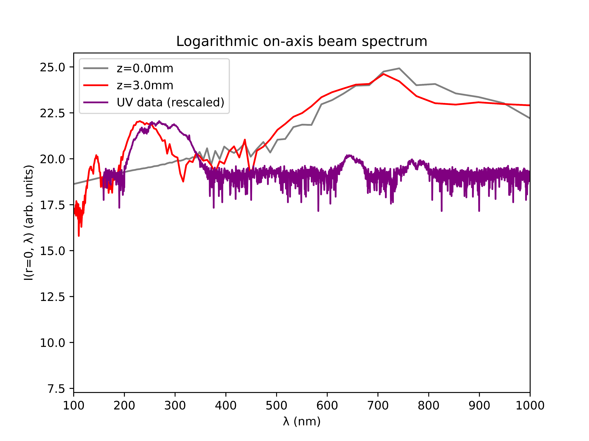
Case study: Argon at 1.0bar with 150mW
COMSOL
gradient

Slide 15
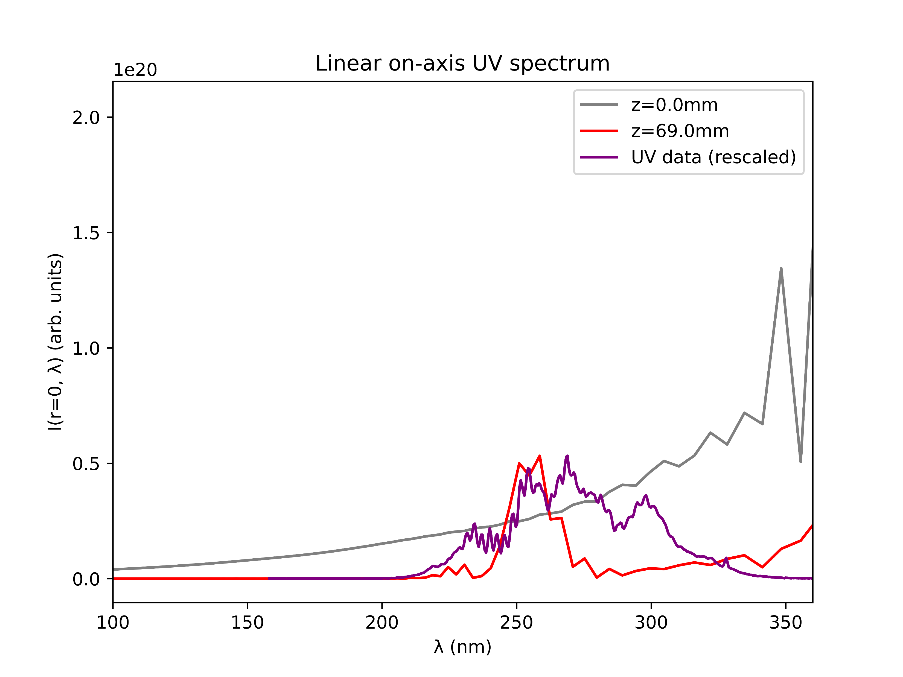
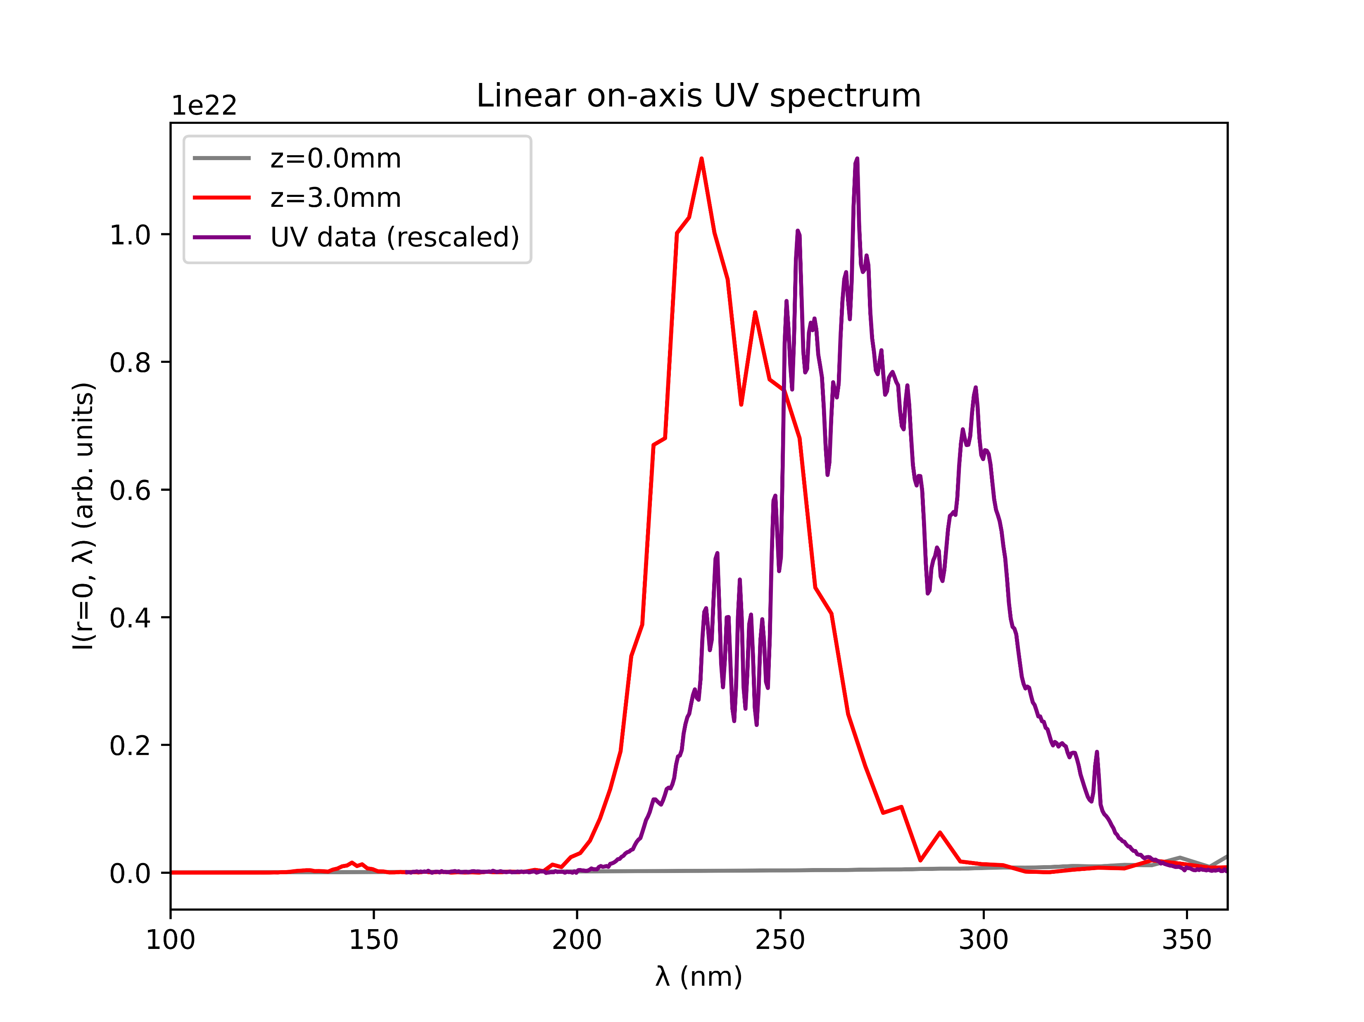
Case study: Argon at 1.0bar with 150mW
COMSOL
gradient

Slide 16
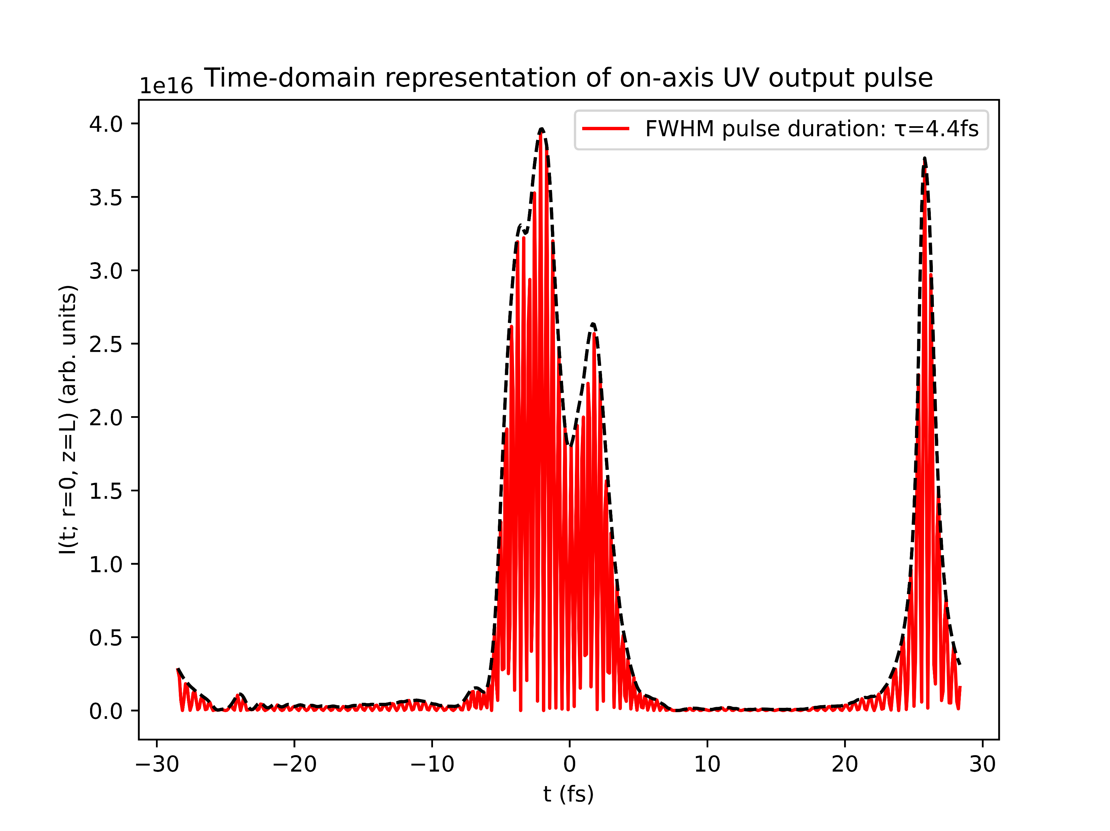
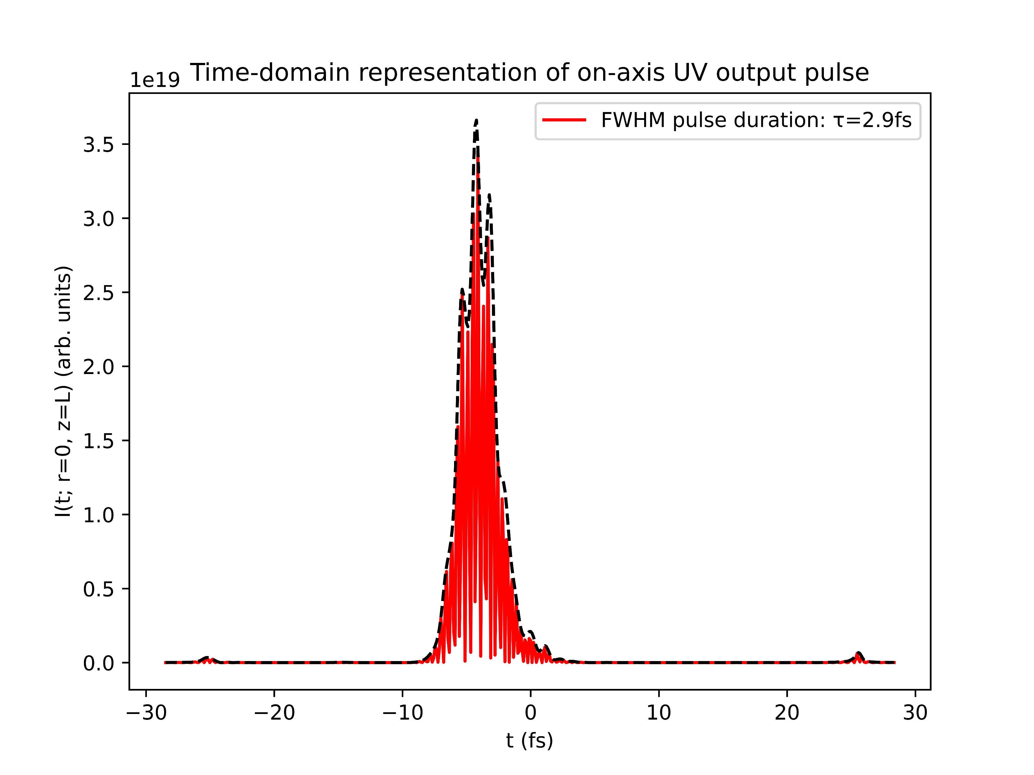
Case study: Argon at 1.0bar with 150mW
COMSOL
gradient

Slide 17
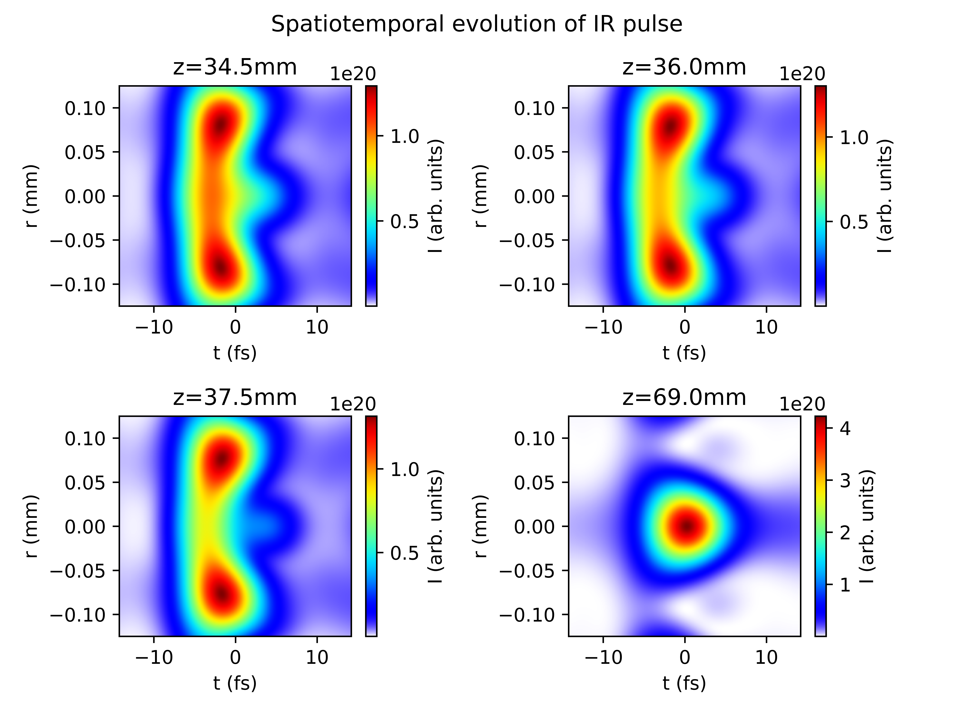
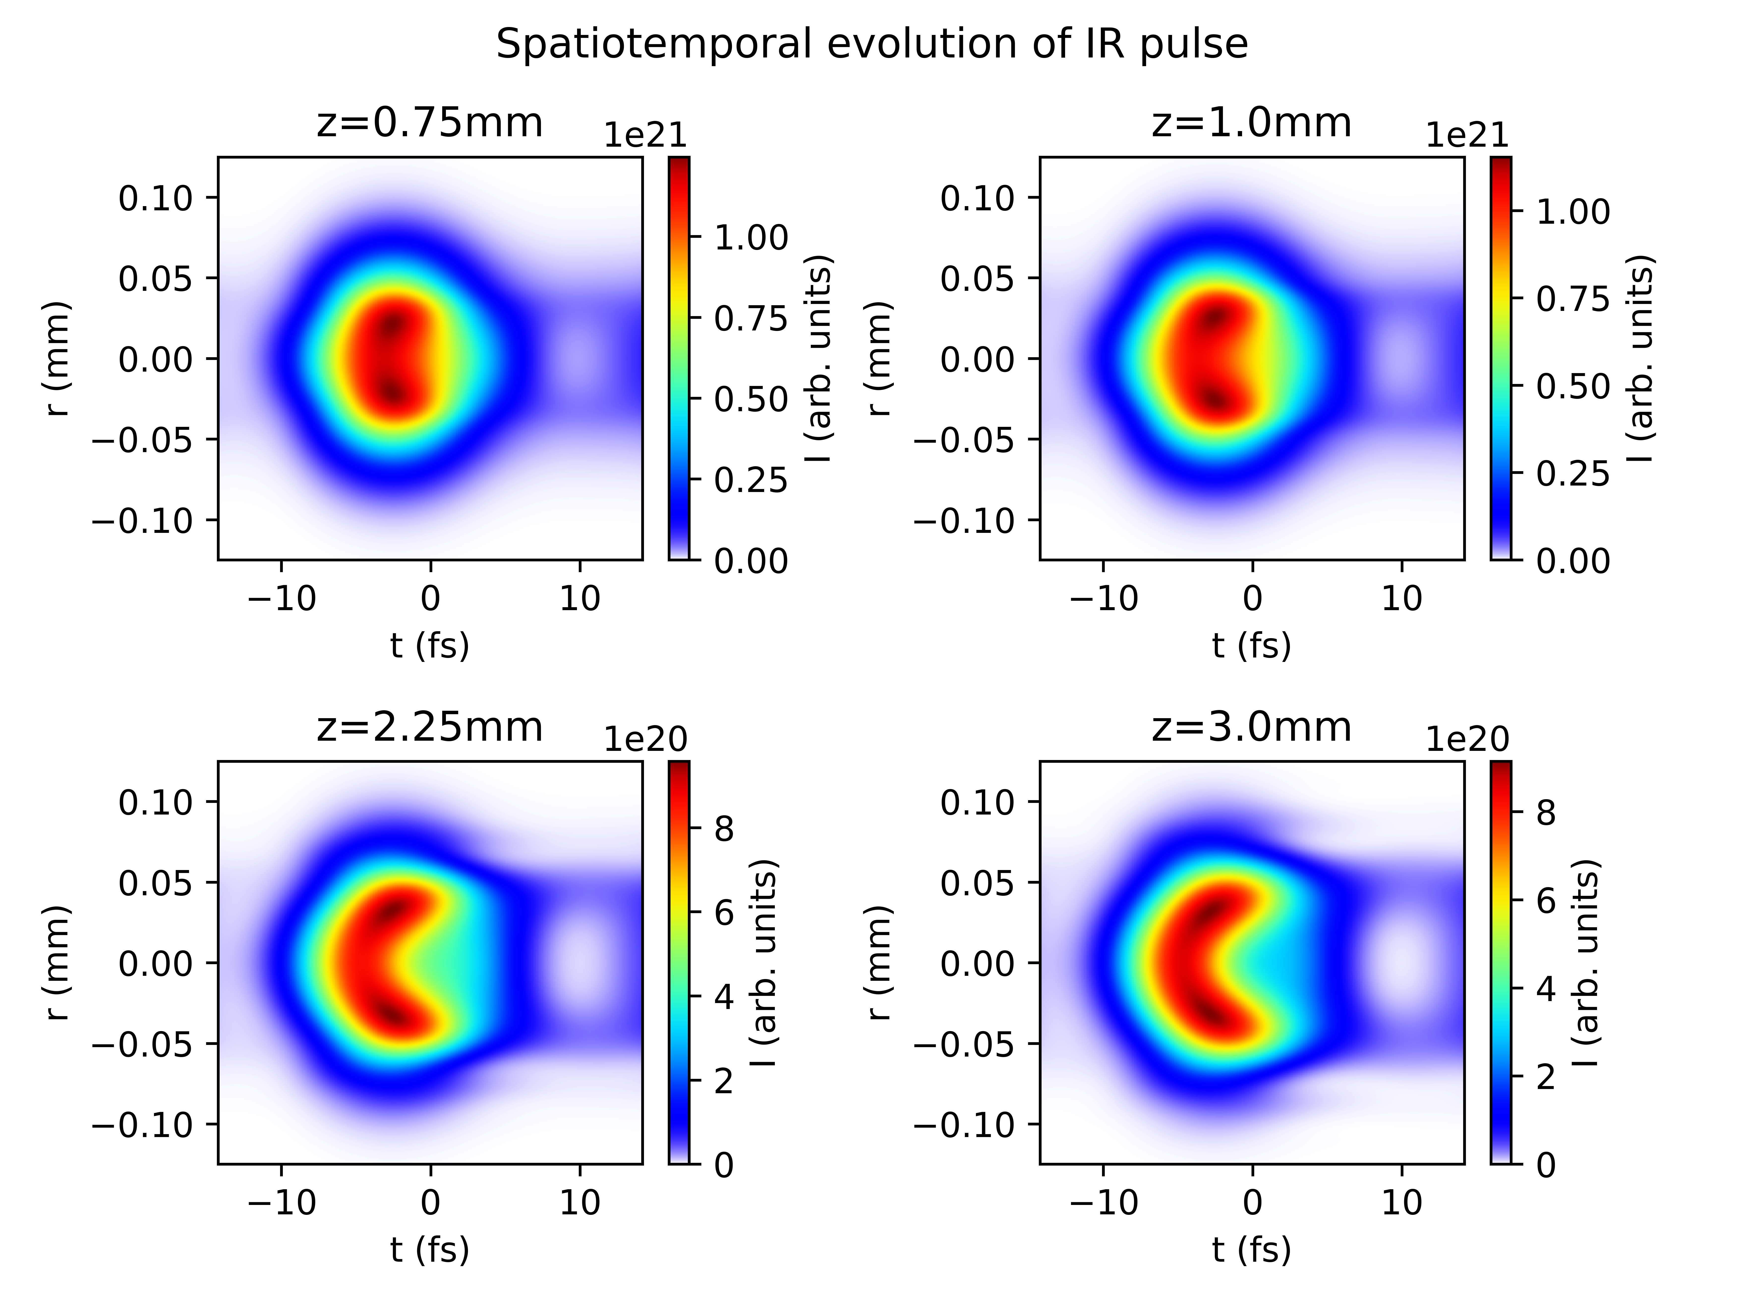
Case study: Argon at 1.0bar with 150mW
COMSOL
gradient

Slide 18
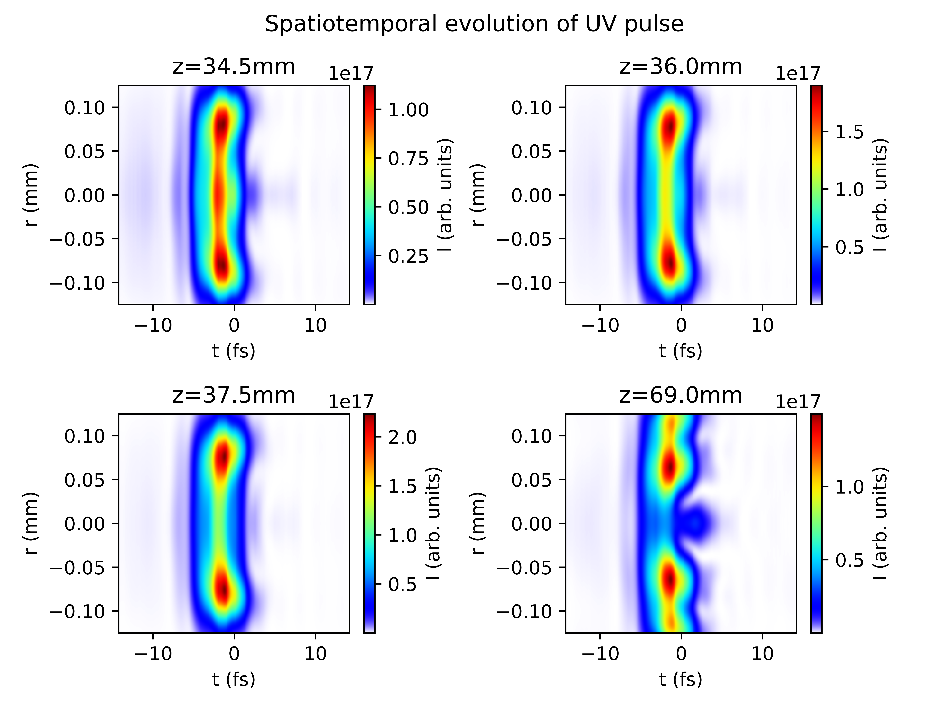
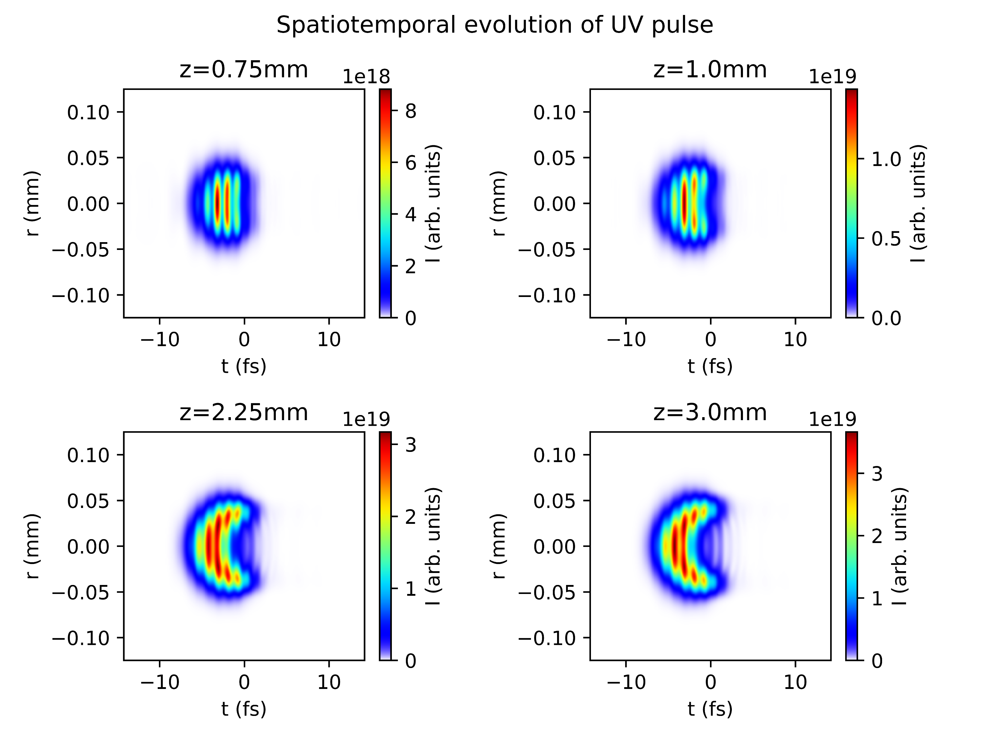
Case study: Argon at 1.0bar with 150mW
COMSOL
gradient

Slide 19
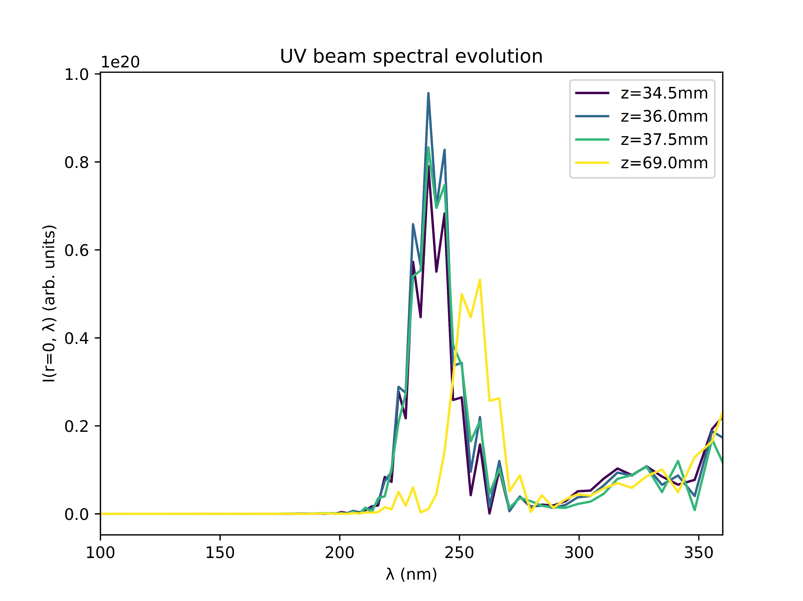
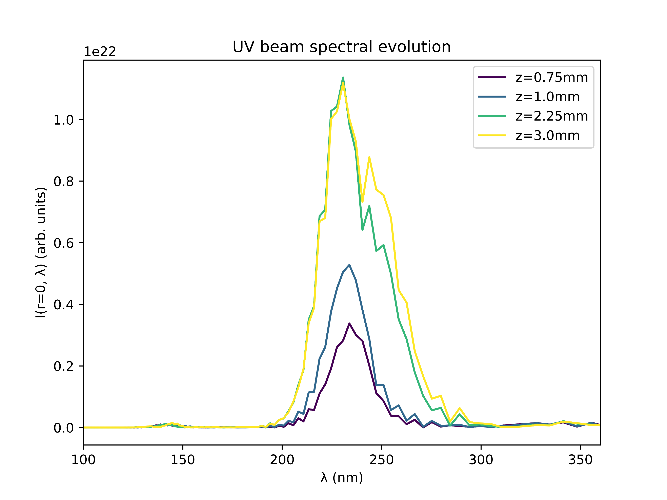
Case study: Argon at 1.0bar with 150mW
COMSOL
gradient

Slide 20
Conclusions
Despite the relatively good agreement of the gradient and COMSOL models within the cell, the simulation output is drastically different
Apart from the scale of the UV output energy, the gradient model seems to produce results that agree more closely with the expected and measured pulse properties
The relevant factor appears to be the propagation of the pulse outside the cell, which is neglected in the gradient model
Compare gradient model to a truncated COMSOL model involving only the cell itself?
Investigate propagation of the pulse before and after the cell?

Slide 21
II. GAS COMPARISONS

Slide 22
Gas comparisons
Show different pressure scan results?
Compare: which gases saturate and which don’t?
When do they saturate? At which pressures and peak energies [both models]
Look at spectra: any peculiar peaks?
Cut-off in UV peak intensity position?
MOST OF THIS IS BASED ON COMS DATA AND PARTIALLY UNFINISHED!!

Slide 23
Energy saturation
The table below indicates whether UV energy saturation sets in at the pressure range considered (0.1bar to 5.1bar) for different gases and beam powers
Beam power | Ar | Ne | He | Kr | Xe | N2 | N2O
75mW | Y | N | N | Y | N?* | Y | Y
150mW | Y | N | N | Y | N?* | Y | Y
200mW | Y | N | N | Y | N?* | Y | Y
300mW | Y | N | N | Y | N?* | Y | Y
400mW | Y | N?* | N | Y | N?* | Y | Y?**
Y: yes, N: no, ?: unknown due to unfinished scan,
*N for coms, ? For grad; Indication is that no saturation sets in
**same as above but with yes
Thus, four saturable gases (Ar, Kr, N2, N2O) and three non-saturable gases (Ne, He, Xe)
For non-saturable gases: benefit in increasing pressure further!

Slide 24
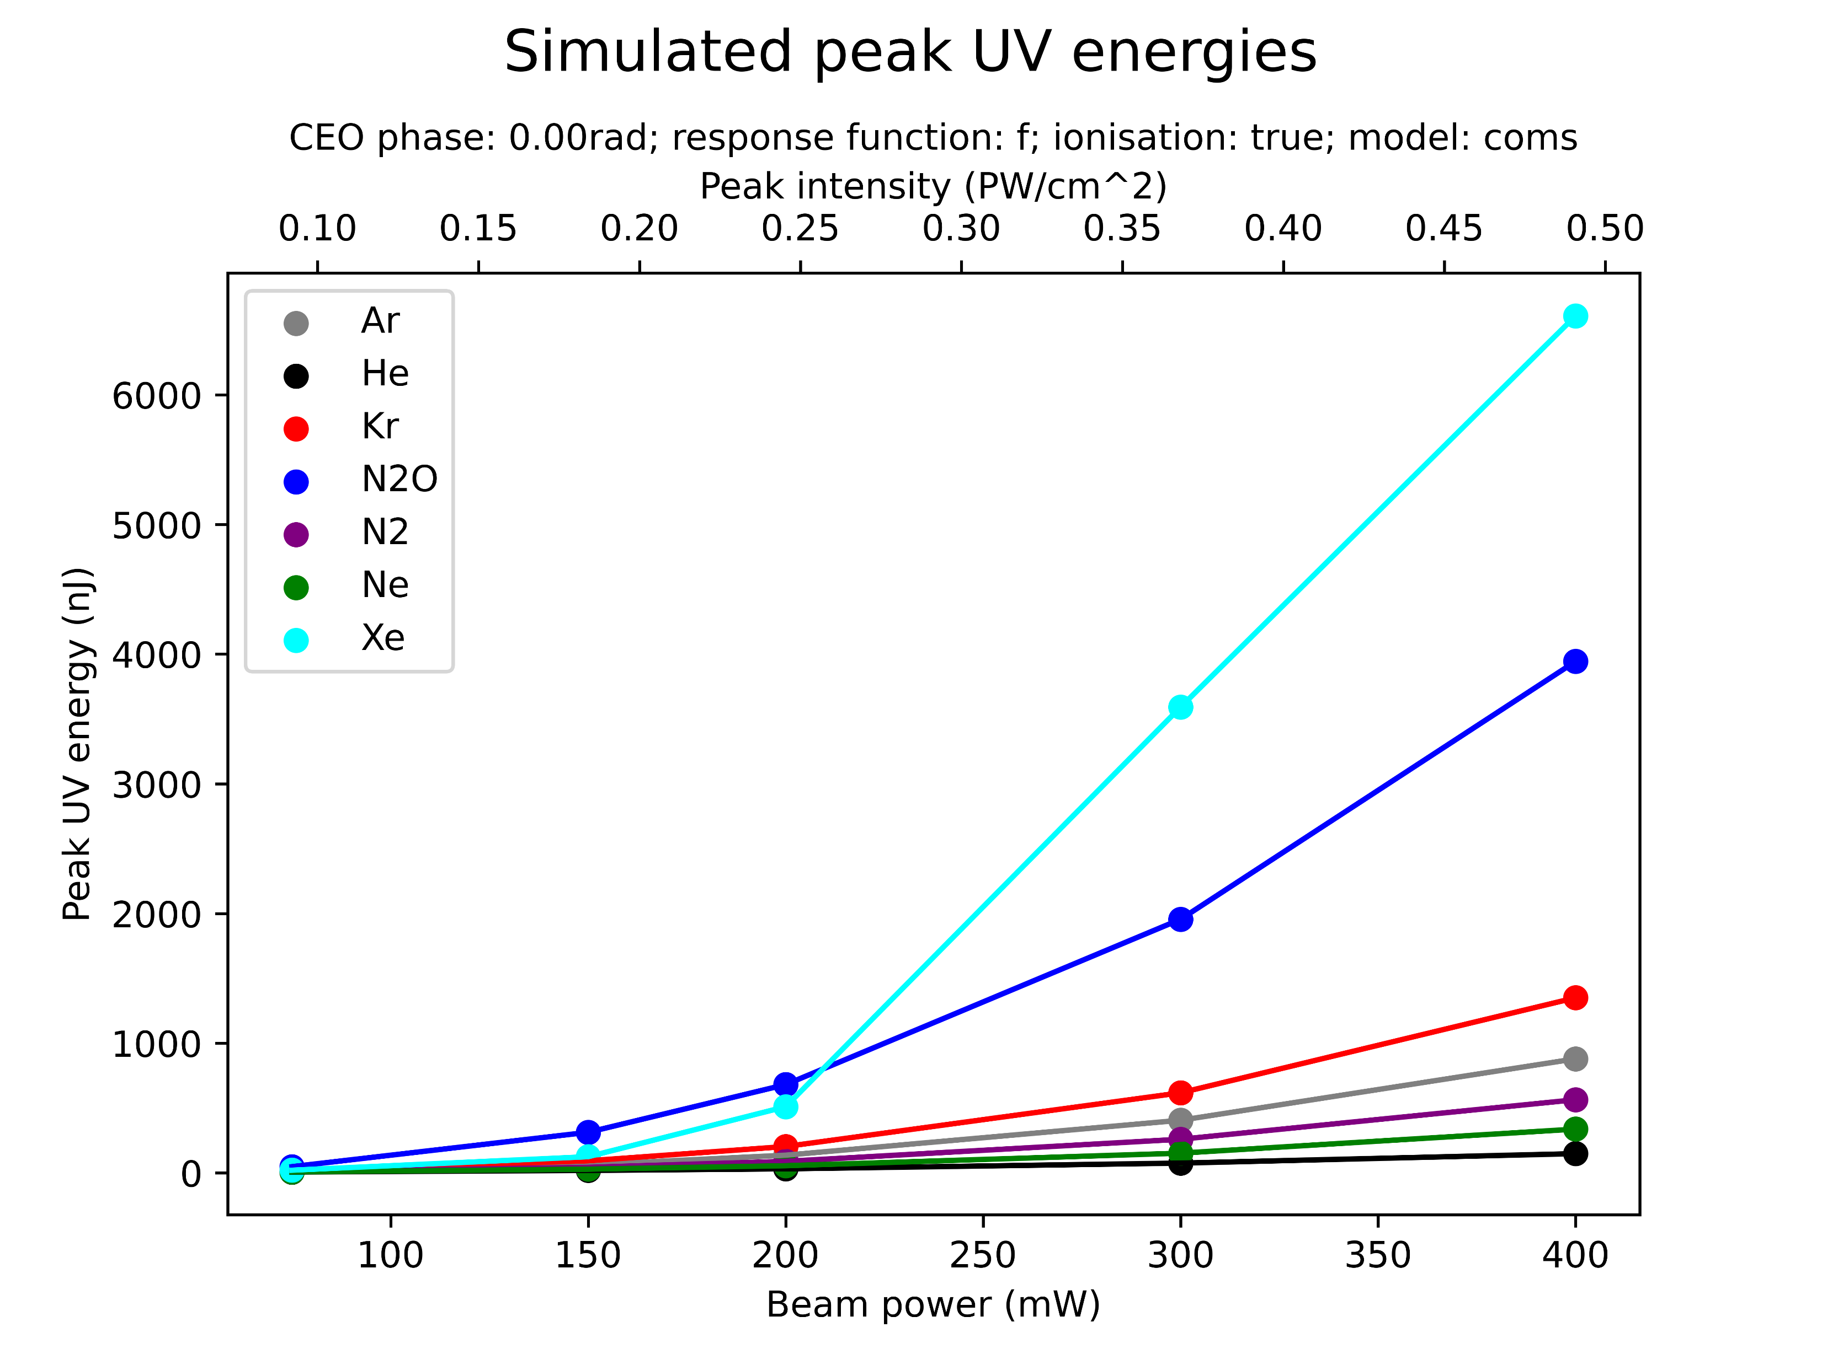
Peak energies
Note: due to unfinished scans the energies of the non-saturable gases might be underestimated!
Xe and N2O significantly more powerful than the rest
He and Ne particularly weak
Note: all non-saturable gases in either top or bottom of ranking, if pushed higher and higher could all overtake the middle ground of saturable gases ?!
[No grad data ready yet, but qualitatively should be the same ranking]

Slide 25
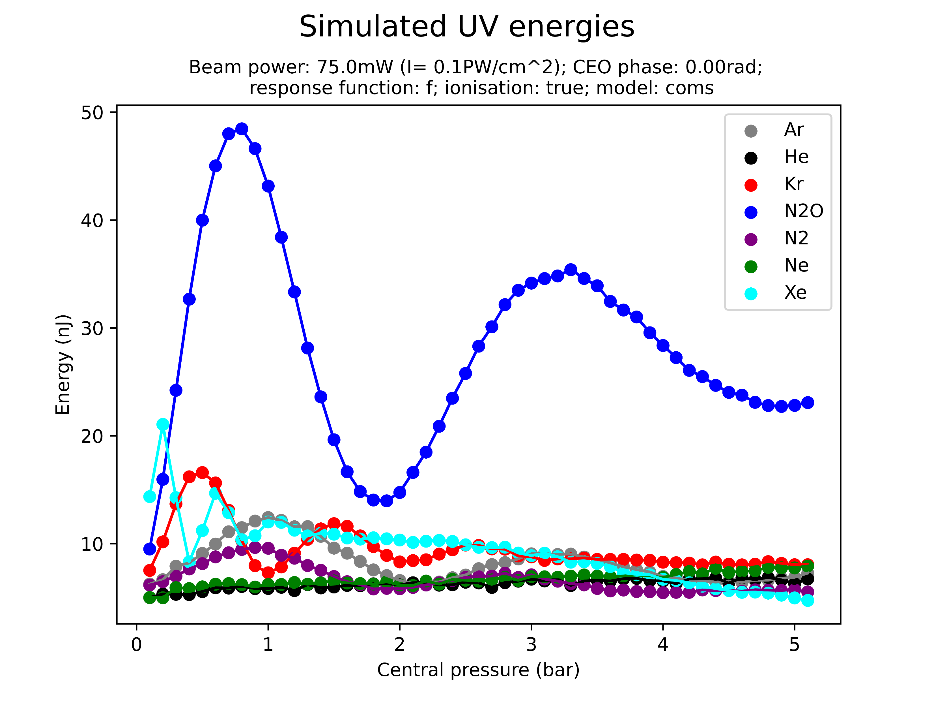
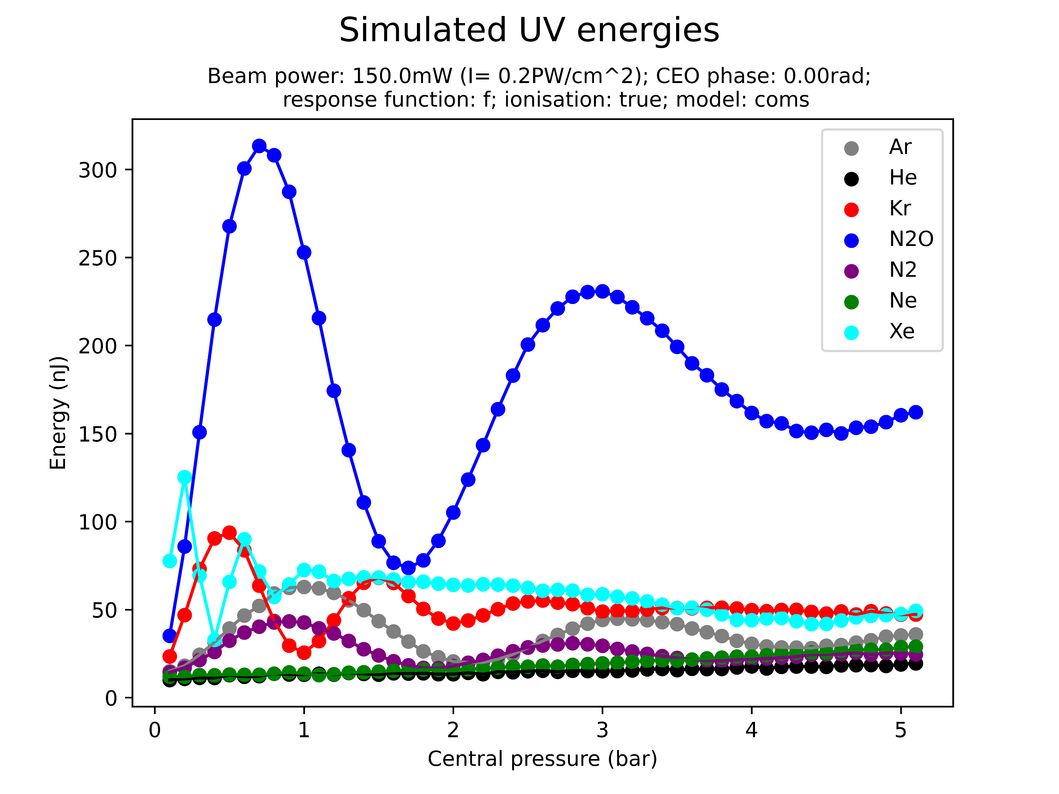
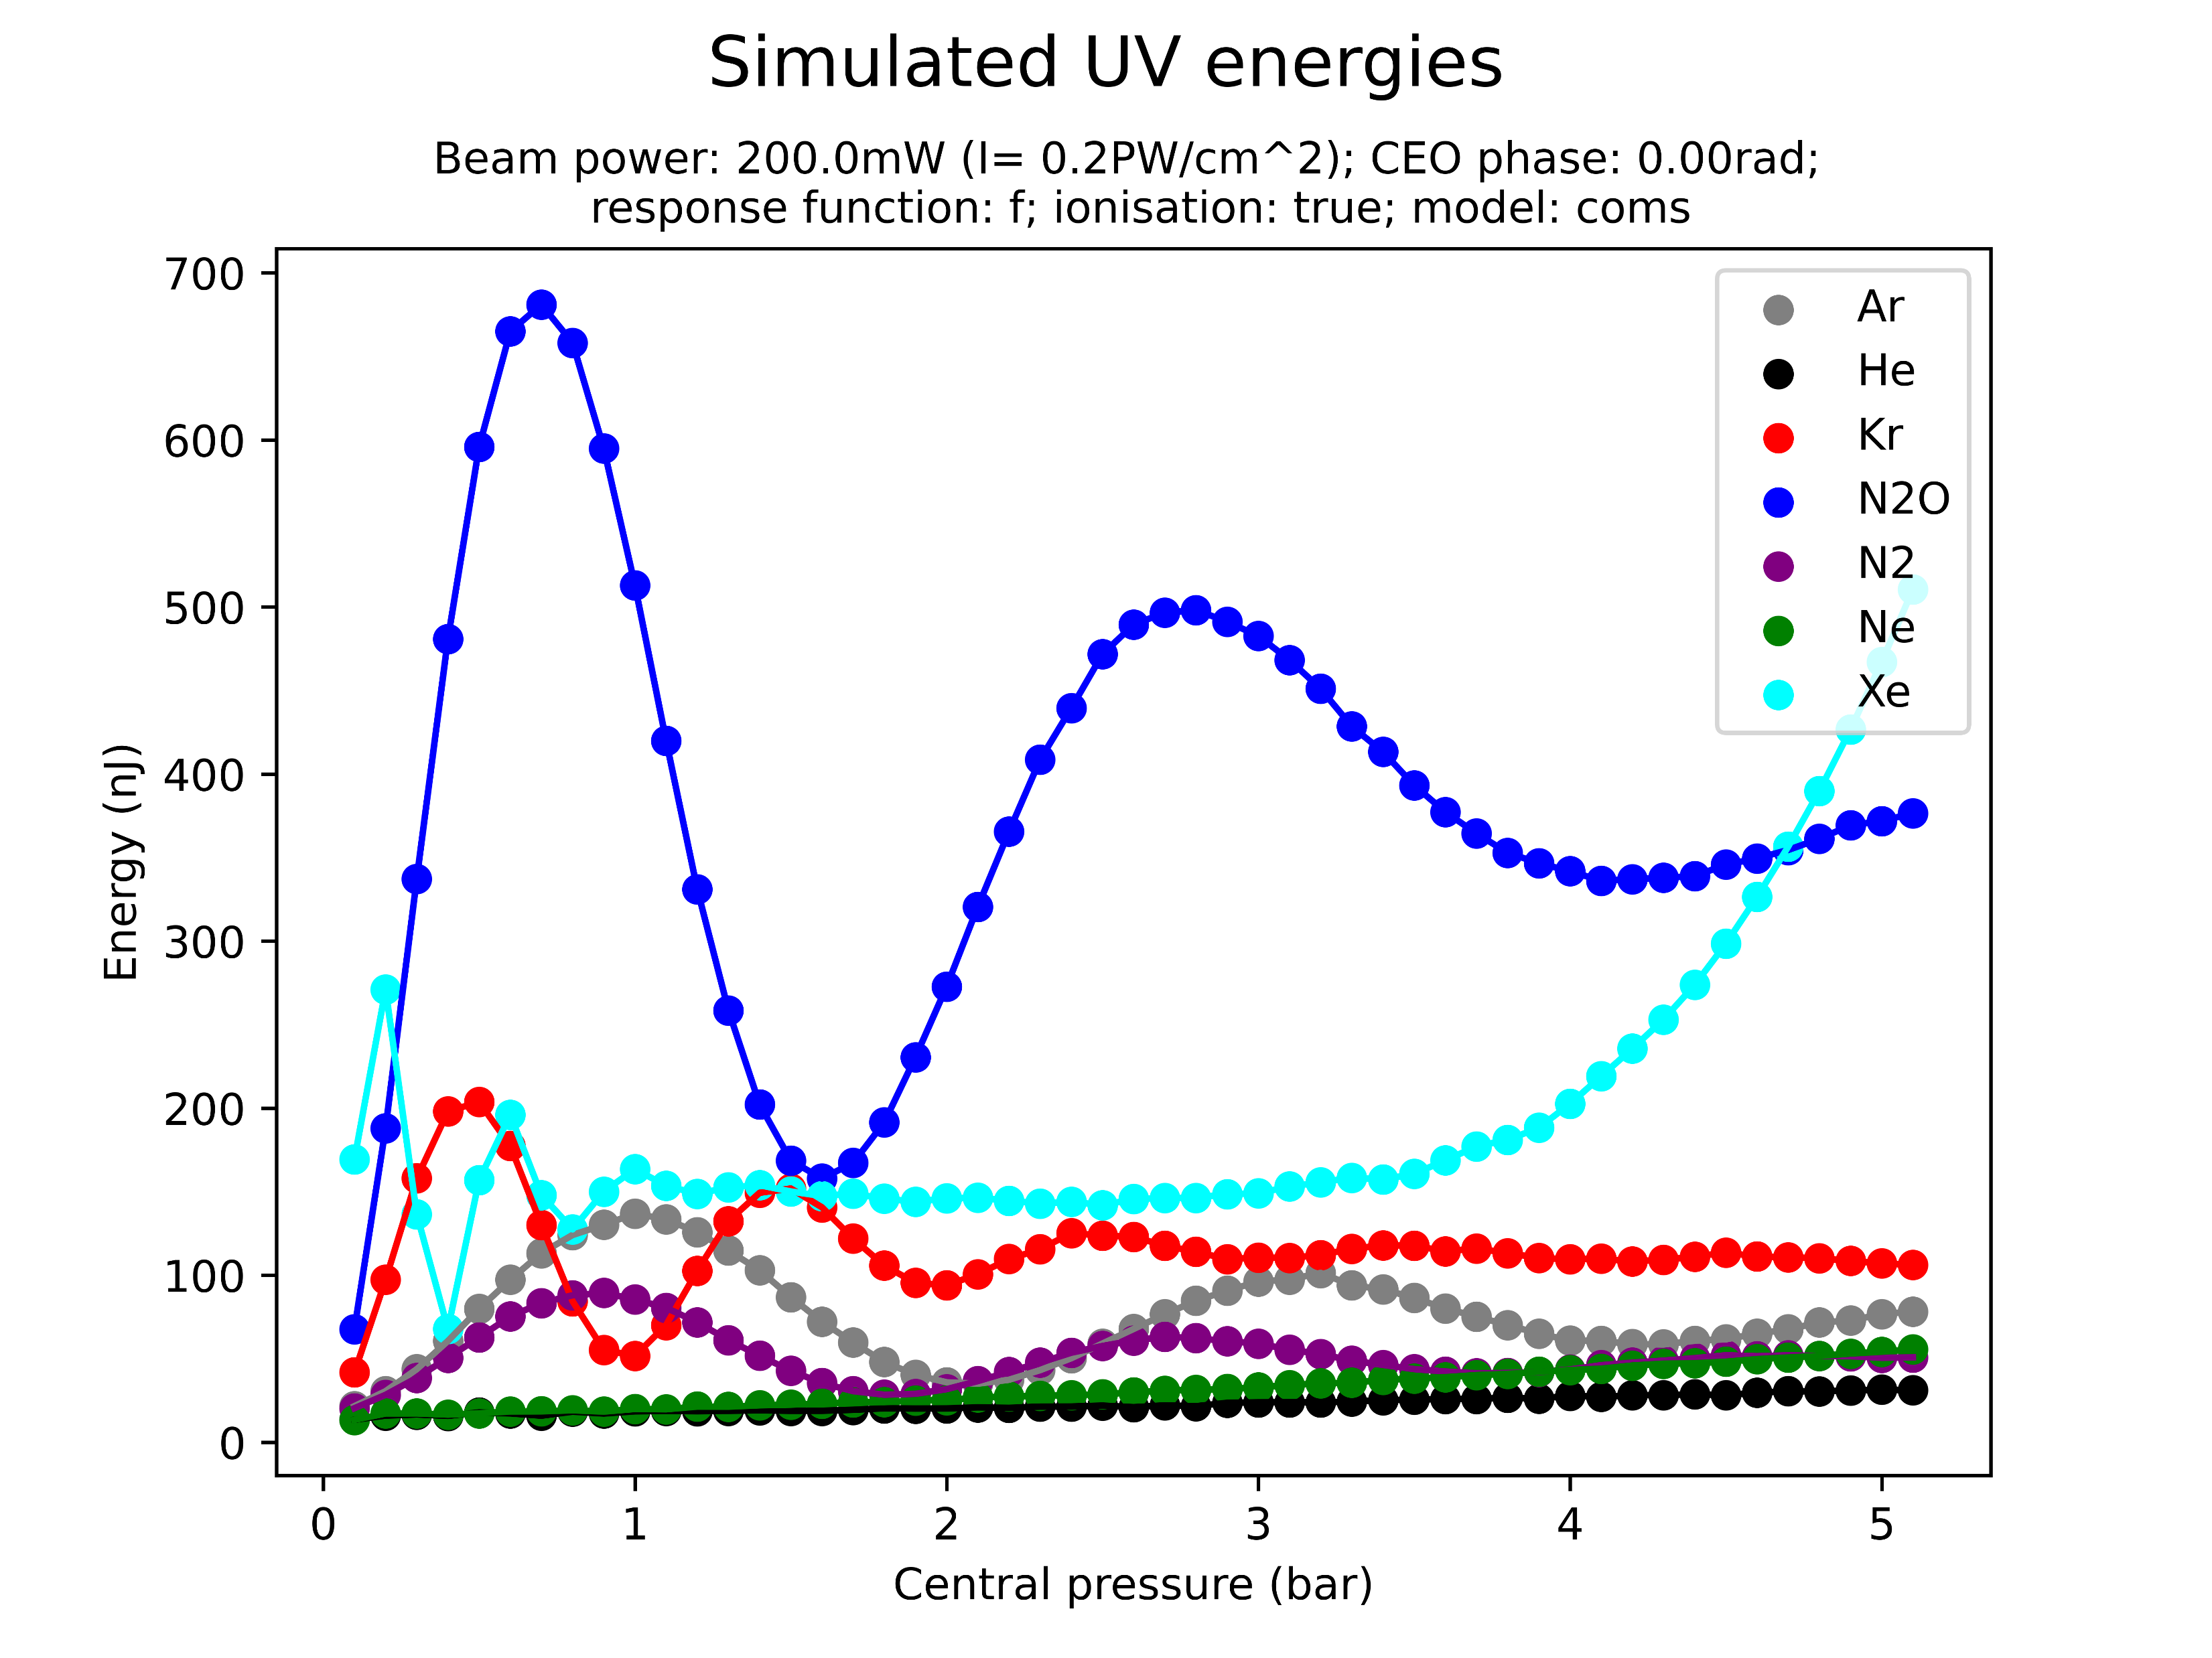
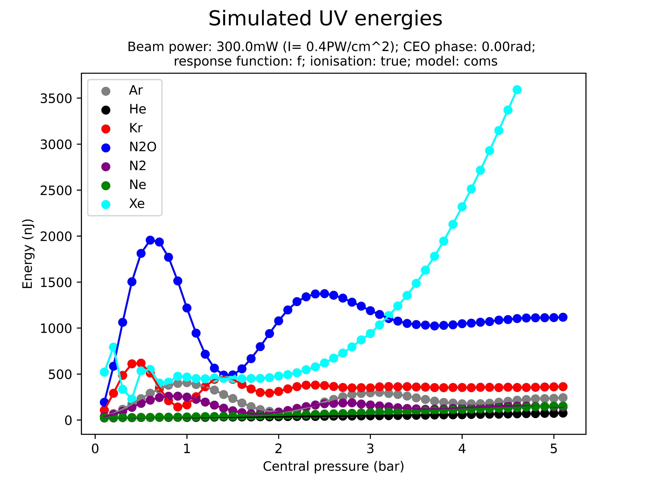
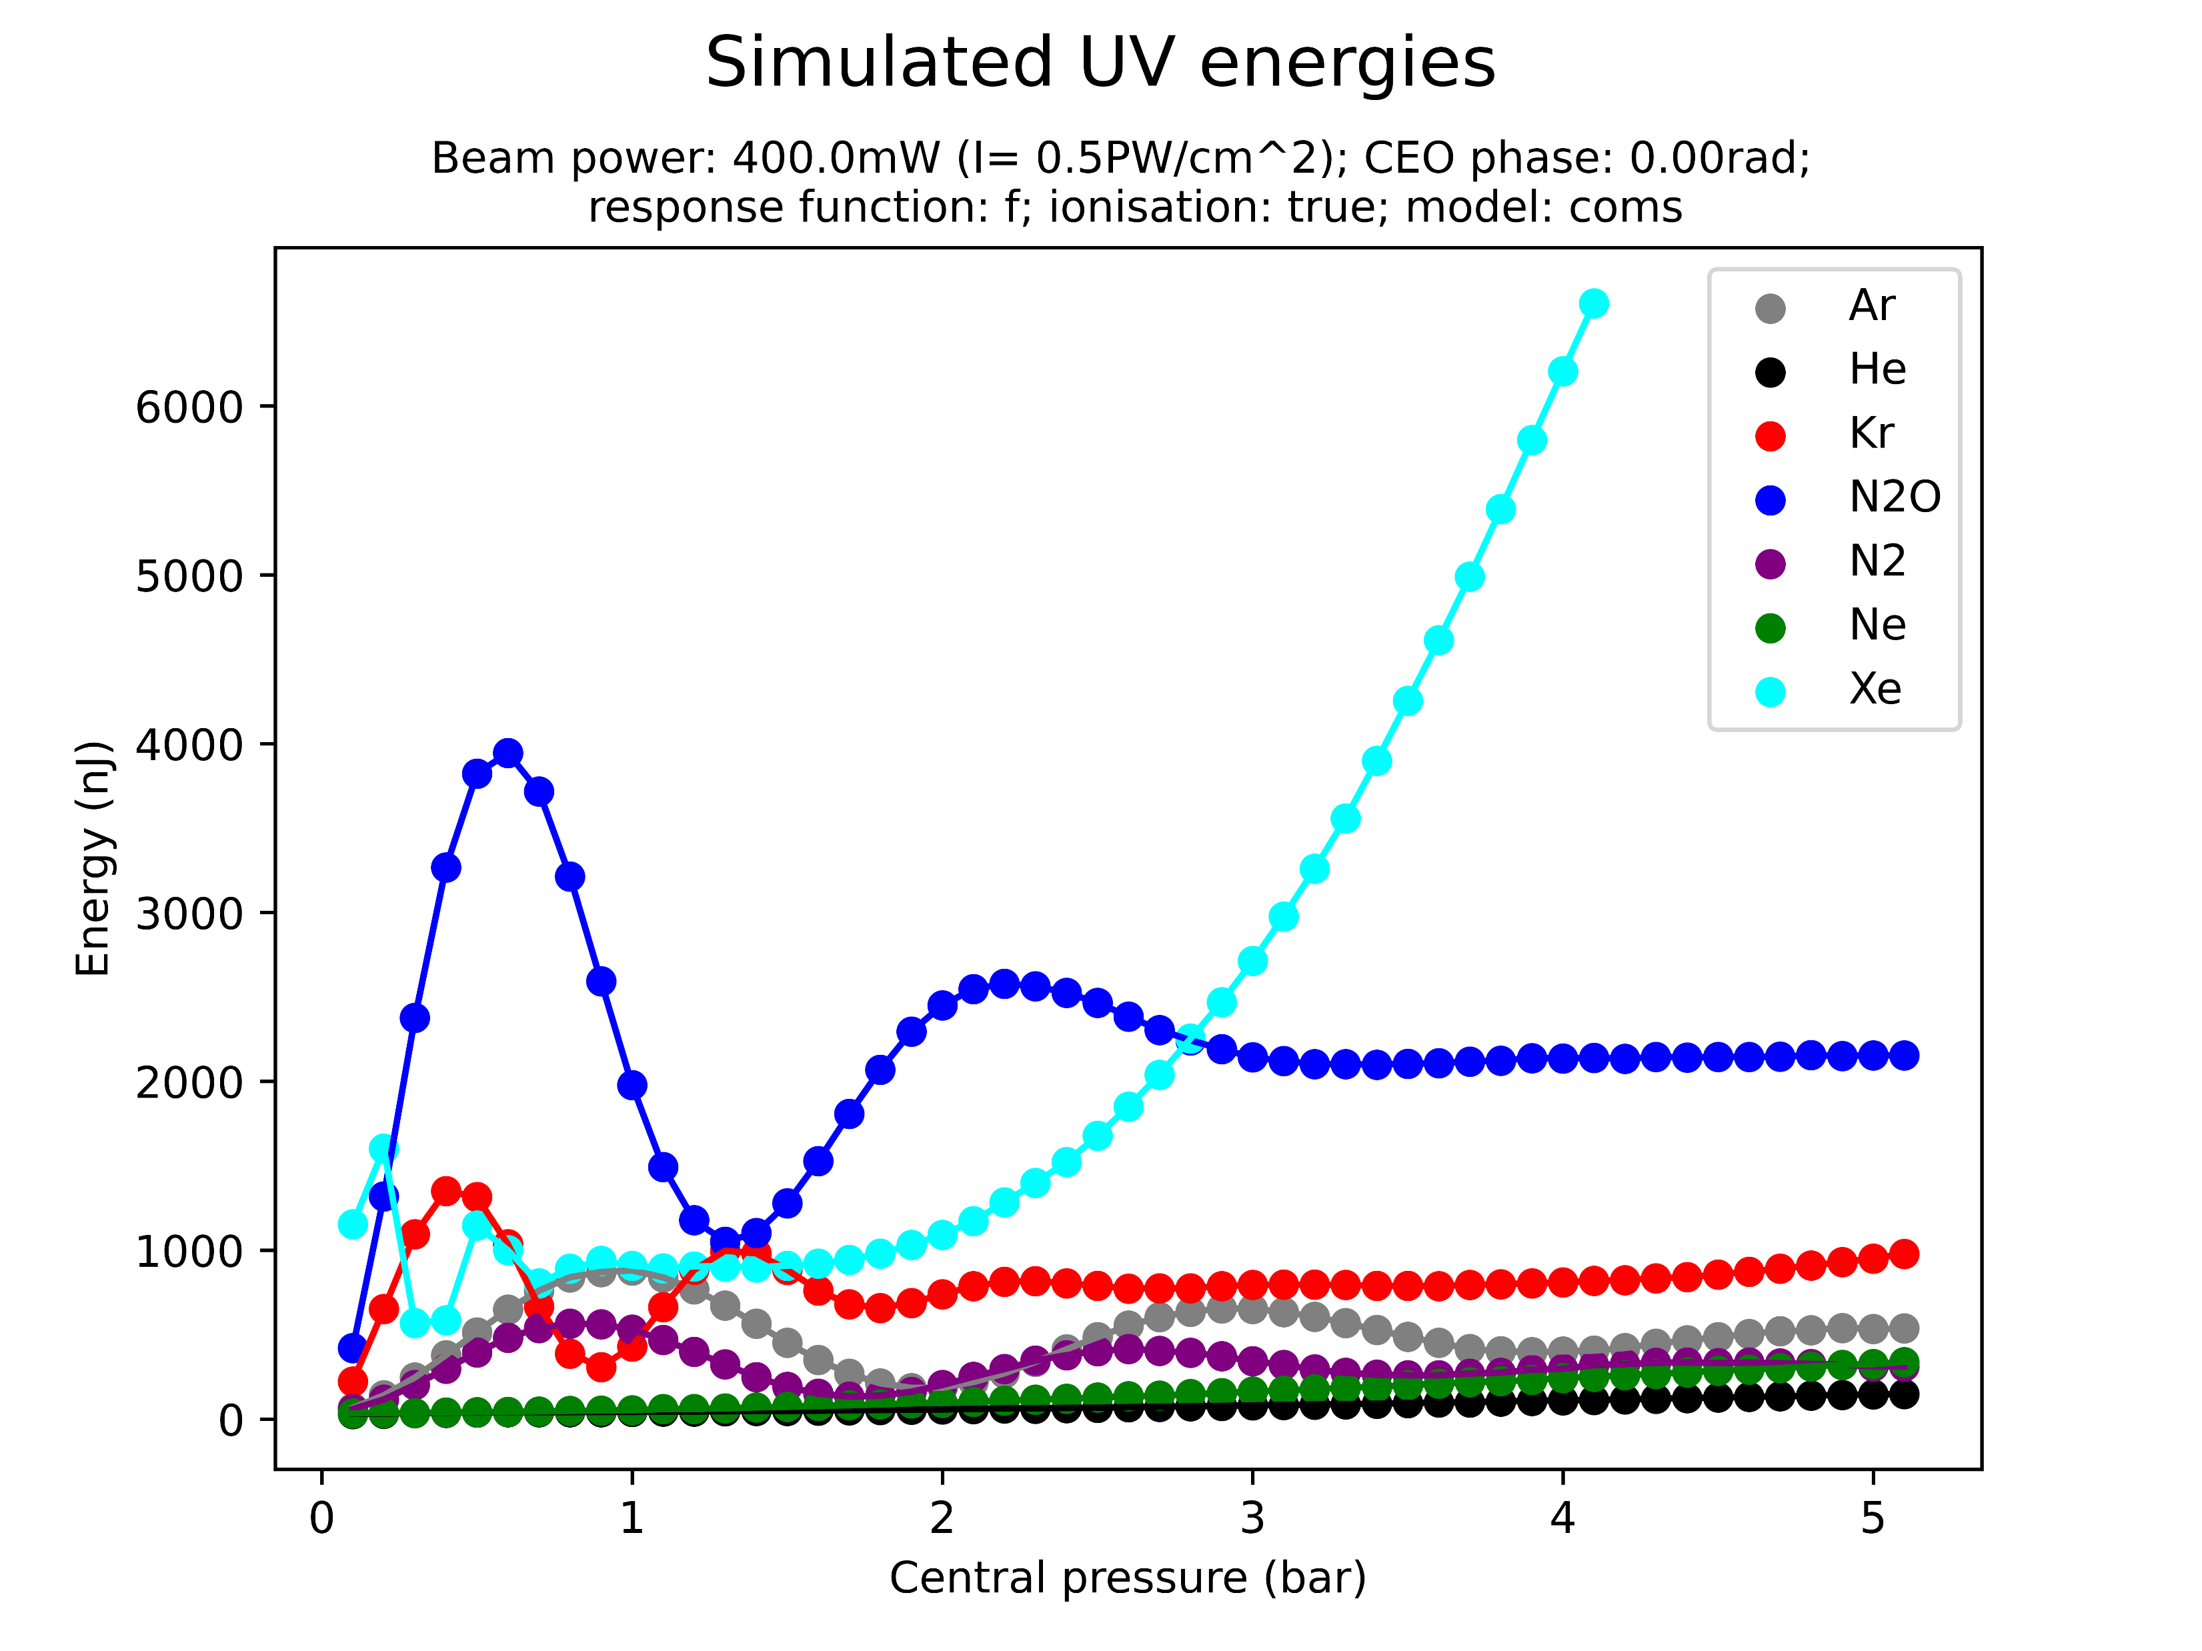
Pulse energies (more detail)
The peak energy is a fairly good indicator!!

Slide 26
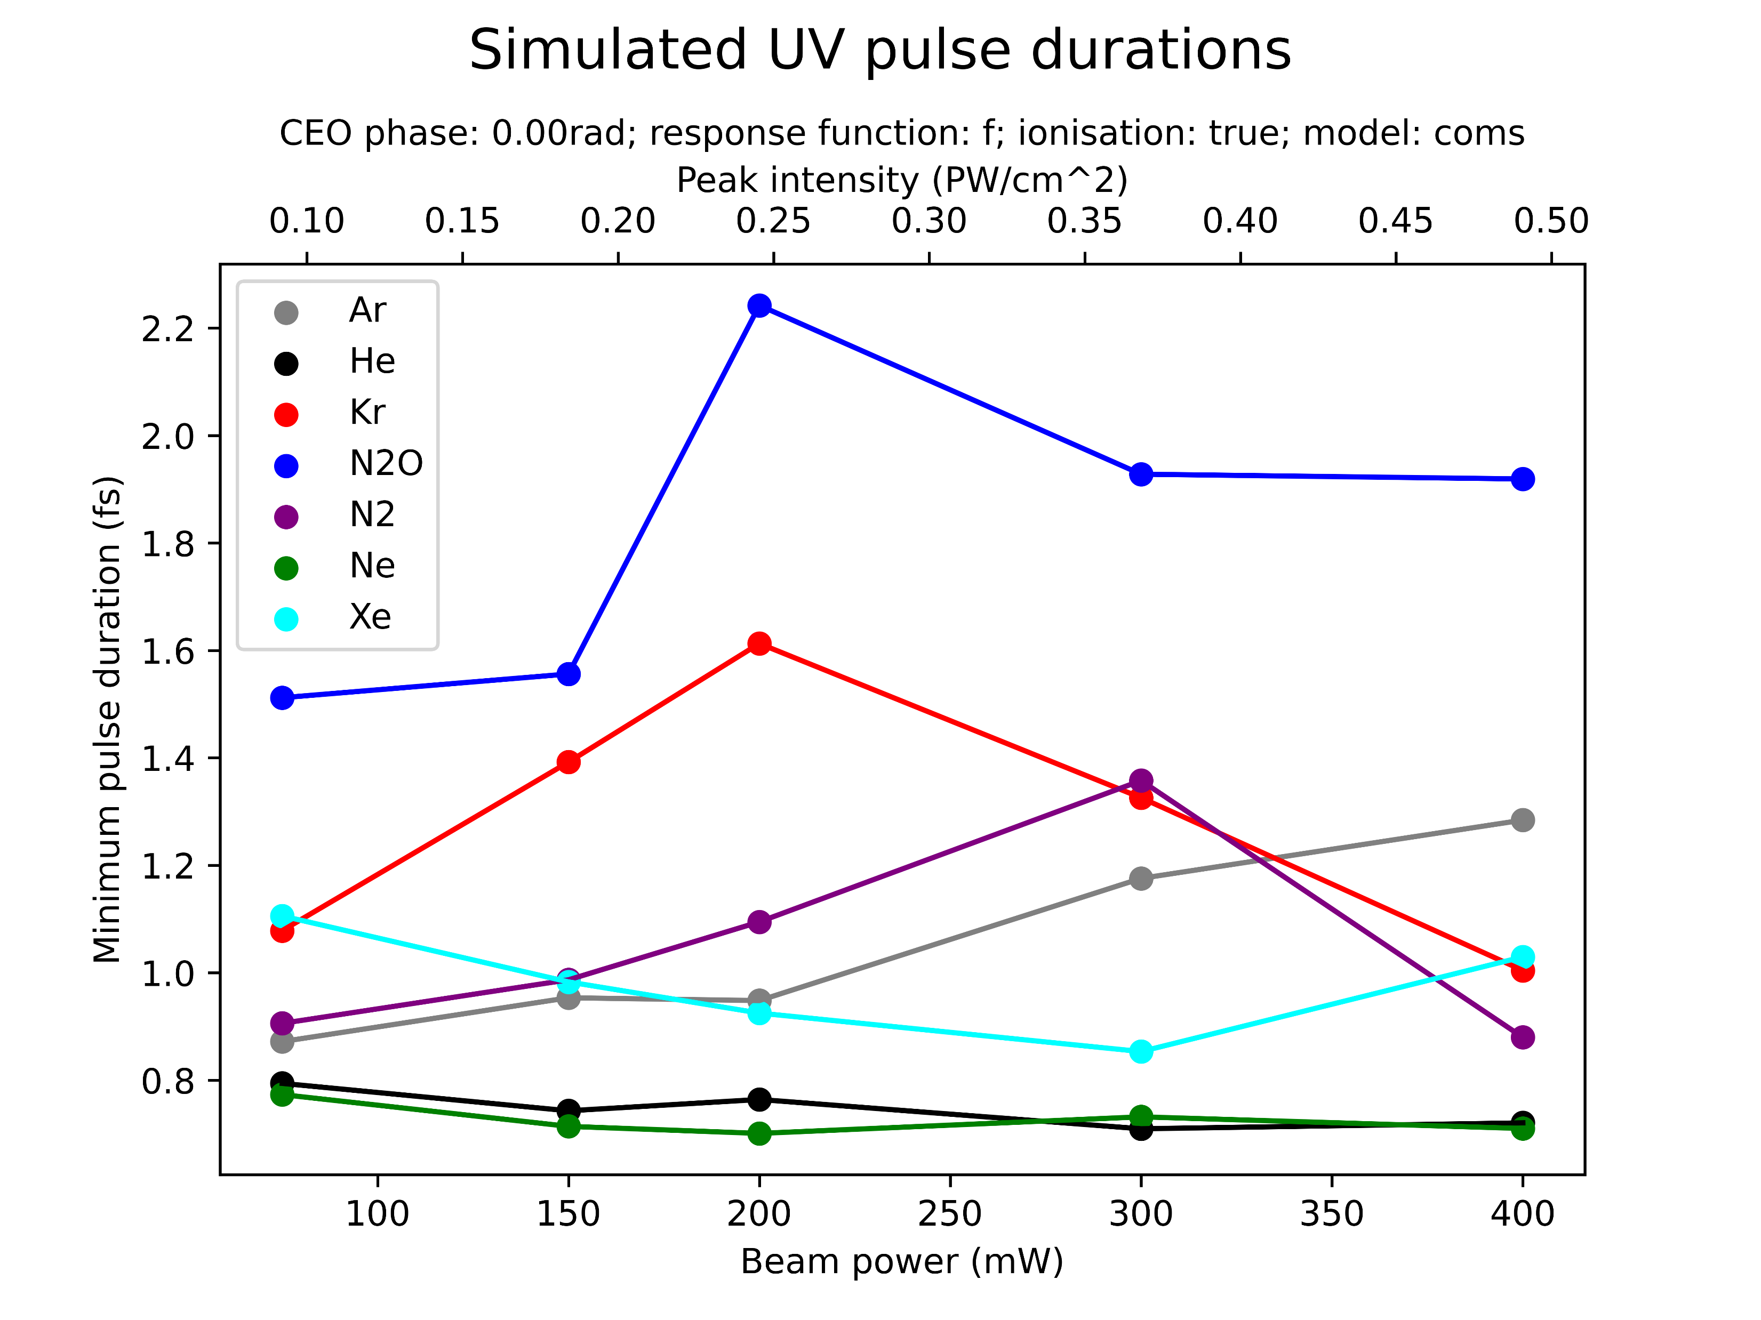
Pulse durations
Note: the graph shows the minimal pulse duration across all pressures; this includes insignificant low-energy UV fluctuations at very low pressures
Also note: still unfinished & no grad data
Very shortest pulses produced by Ne and He (but as we saw, low energy)
Longest pulses by N2O and Kr
Ar, Kr seem good middle ground when it comes to energy and pulse duration
Xe exceptional: high energy and short pulses
But: very careful with interpretation! These are the shortest possible pulses across all pressures and do not correspond to the average pulse duration at a given beam power! Also careful with linking to energy!! This is more of a show of potential
Next section has numerical values to better understand!

Slide 27
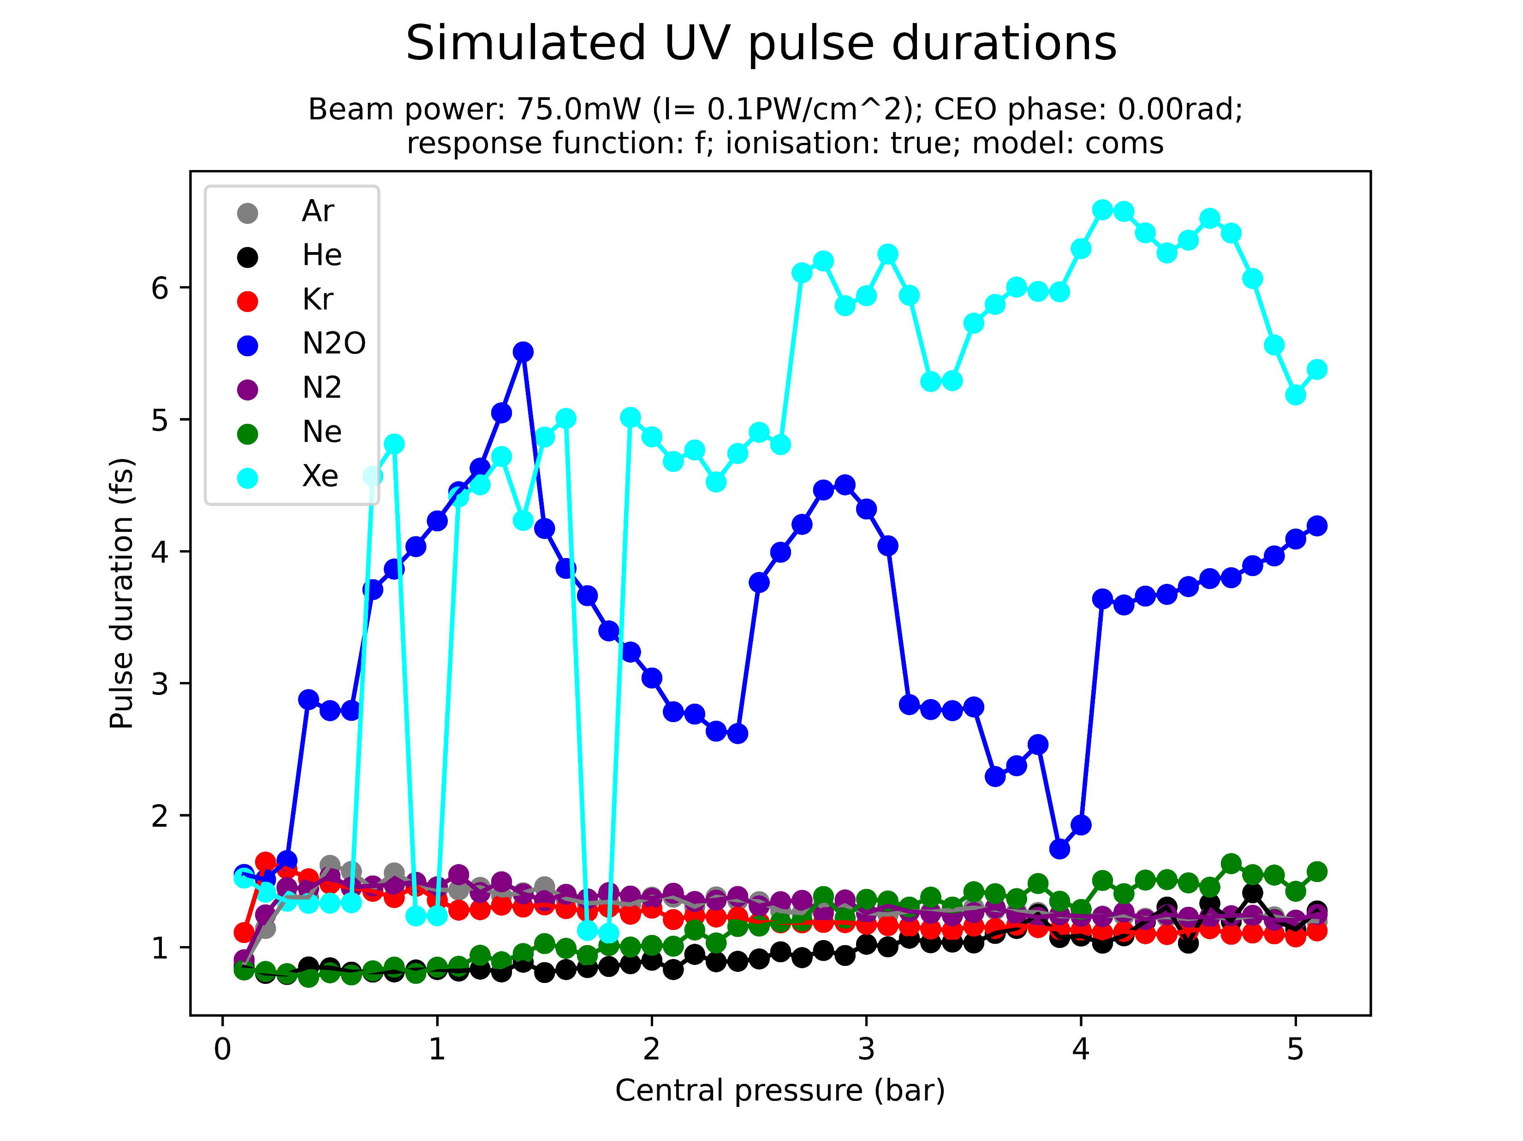
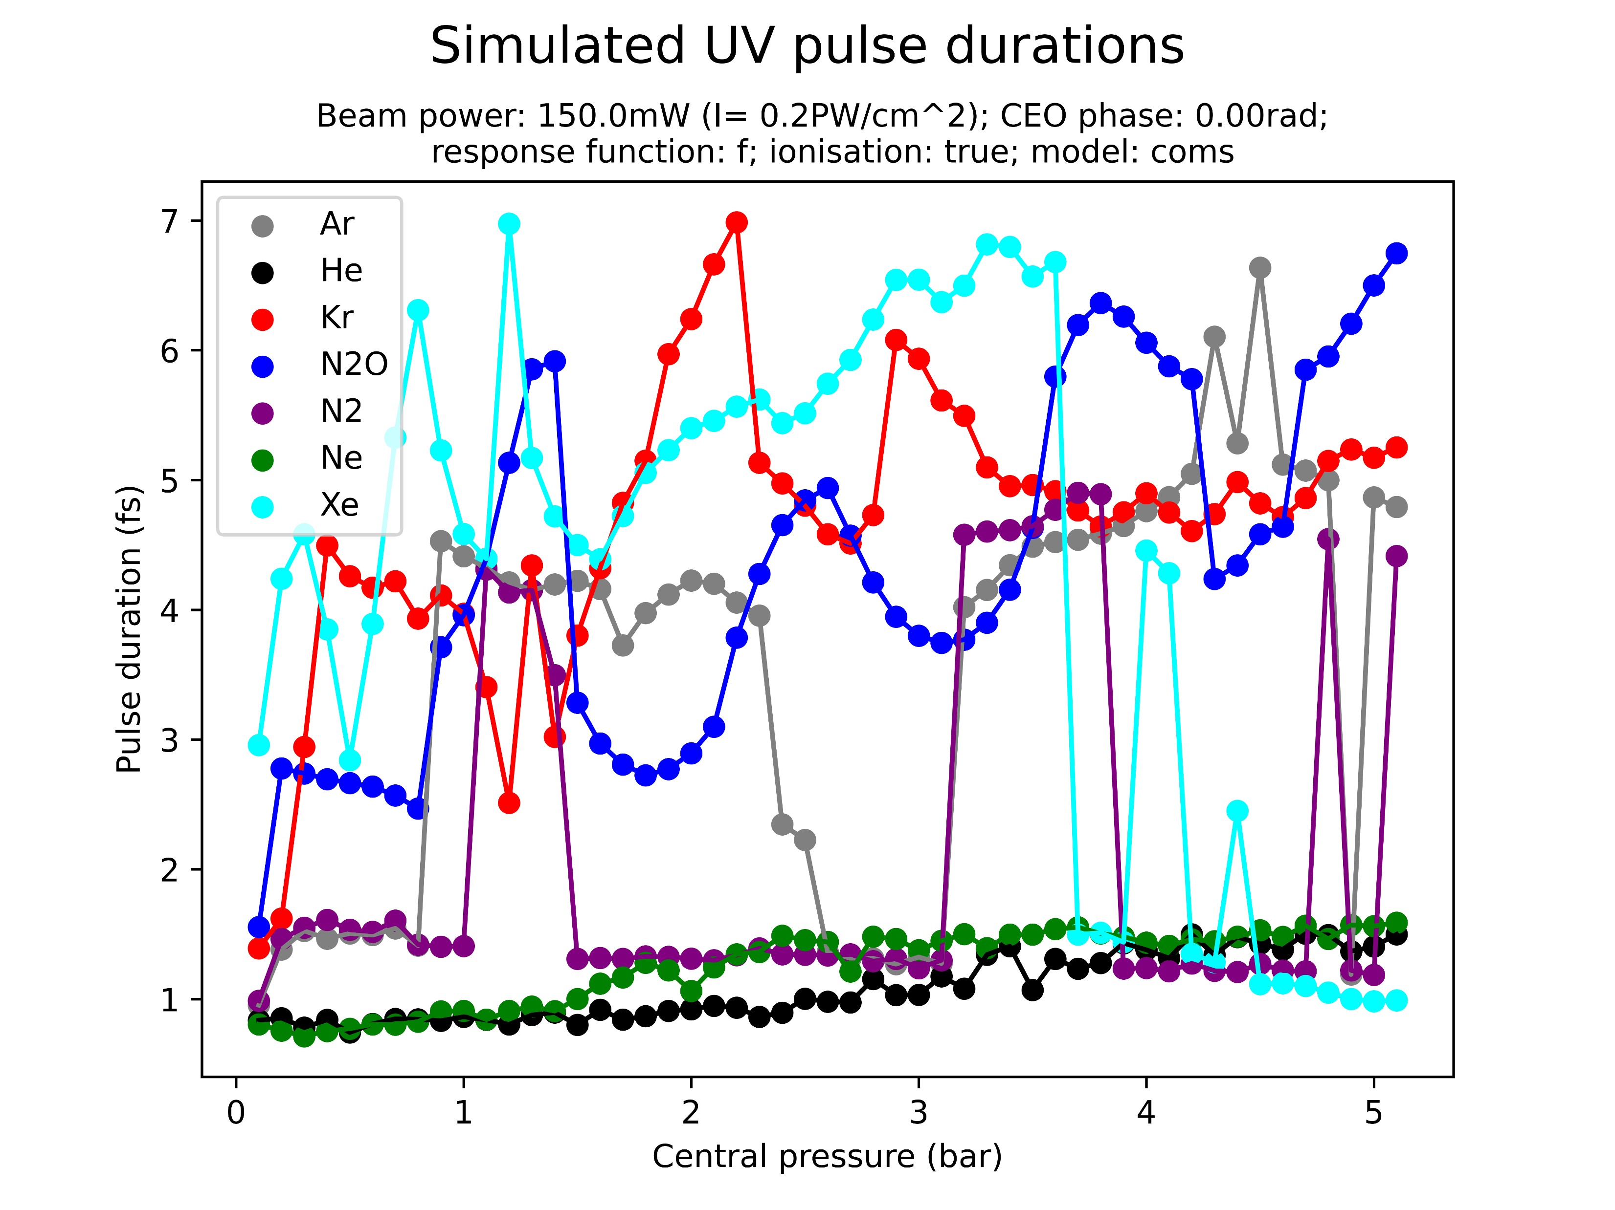
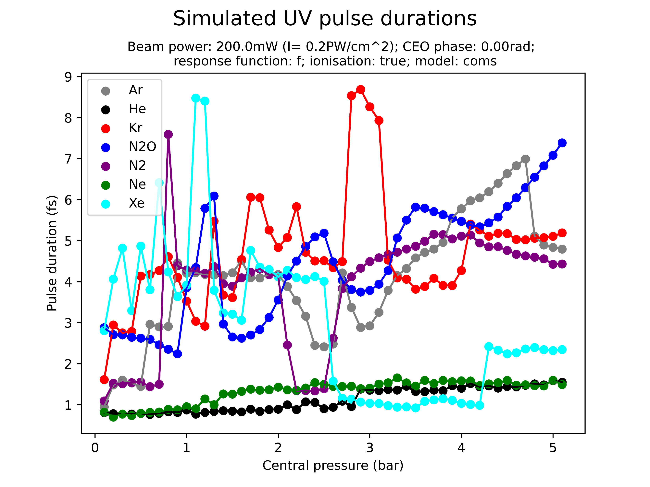
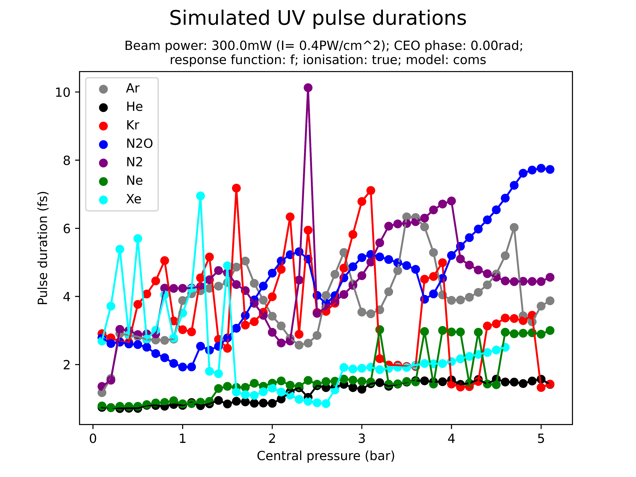
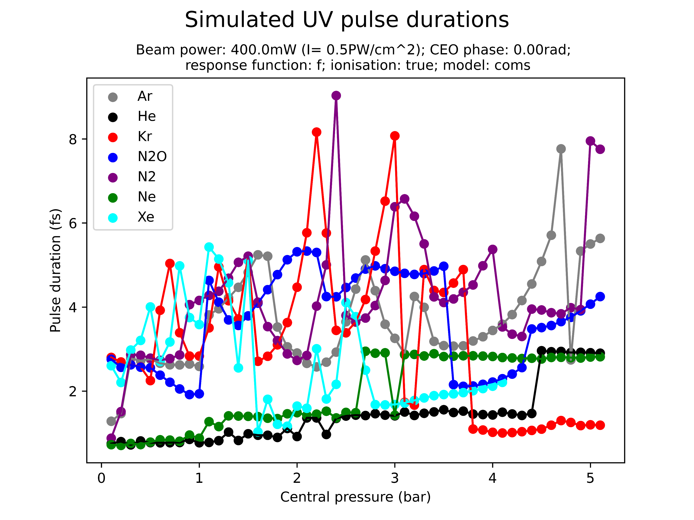
Pulse durations
The plots on this and the following slides indicate how the previous plot could be misleading and how pulse width is sensitive to beam power and pressure
Slightly confusing and painful to look at but paint a better picture
Shortest possible time is not a good indicator!

Slide 28
“Peak UV position shift”
See figure for what is meant

Slide 29
III. CONDITIONS OF INTEREST

Slide 30
In previous section we saw that complex relationship between gas type, beam power, gas pressure, pulse duration and pulse energy
Difficult to work with general relationships
For this reason, isolated a few particular cases (by manually looking at the output, difficult to do this systematically)
The following are more or less estimates and not very rigorous!

Slide 31
Conditions of interest
The following table shows parameter combinations which are predicted to result in energetic (>100nJ) and short (sub-2fs) UV pulses
Gas | Beam power | Pressure | Density model | Pred. duration | Pred. energy
Ne | 400mW | 0.1-2.5bar | grad | 0.5-0.8fs | 100-800nJ
He | 400mW | 2.0-4.0bar | grad | 0.8fs | 500-1500nJ
Ar | 300mW | 2.5-4.0bar | grad | 1.1-1.5fs | 800-1000nJ
Xe | 300mW | 1.5-2.5bar | COMSOL | 0.7-1.1fs | 500-700nJ
He | 300mW | 2.0-5.0bar | grad | 0.6-1.0fs | 300-1400nJ
Ar | 300mW | 3.5-4.0bar | grad | 1.2fs | 800nJ
Ne | 300mW | 1.0-5.0bar | grad | 0.7-1.0fs | 500-2500nJ
N2 | 200mW | 3.0-5.0bar | grad | 1.5-1.9fs | 400-450nJ

Slide 32
Conditions of interest (cont.)
The following table shows parameter combinations which are predicted to result in energetic (>100nJ) and short (sub-2fs) UV pulses
Gas | Beam power | Pressure | Density model | Pred. duration | Pred. energy
N2O | 200mW | 3.5-5.0bar | grad | 1.1-1.3fs | 700-900nJ
Kr | 200mW | 1.5-3.0bar | grad | 1.3-1.5fs | 500-600nJ
He | 200mW | 3.0-5.0bar | grad | 0.5-1.1fs | 200-450nJ
Xe | 150mW | 0.8-2.0bar | grad | 1.5-1.9fs | 300-500nJ
N2O | 150mW | 3.5-5.0bar | grad | 0.8-1.3fs | 600-800nJ
Kr | 150mW | 1.5-2.5bar | grad | 1.3-1.5fs | 400-500nJ
He | 150mW | 4.5-5.0bar | grad | 1.1-1.2fs | 130-200nJ
N2 | 150mW | 4.0-5.0bar | grad | 1.6-1.9fs | 400-450nJ
Ne | 150mW | 2.1-5.0bar | grad | 0.7-1.1fs | 150-500nJ

Slide 33
IV. NEXT STEPS

Slide 34
Next steps?
Chirp!
Investigate conditions of interest in more detail?
Beam waist? Beam focus?
Run more scans? [corrected with PPT?]
Investigate effect of pulse propagation outside the cell?
Analyse scans more [a lot left to do!!!!]
Look at spectra of different gases! And of COMSOL vs grad!!

